Slide 1
Financial Services Workshop Budget Office Overview
April 2023

Slide 2
University Budget Office Building 165 – 209 East 3rd Street
Dawn Quist – Director
Tim Morris – Budget Analyst
Lisa Edwards – Budget Analyst
Heather Taylor – Accounting Technician
Laura Fanning – Budget Analyst
Yolanda Hill – Accounting Technician

Slide 3
University Budget Office
Provide financial and budgetary support in resource planning, university budget preparation and monitoring for East Carolina University.
Coordinate the preparation of the state budget requests, the university’s all funds budget process and administer those budgets once they are approved.

Slide 4
Why Develop an All-Funds Budget
Requirement of UNC System for a comprehensive operating budget
Planning and use of resources
Align funding with priorities of strategic plan

Slide 5
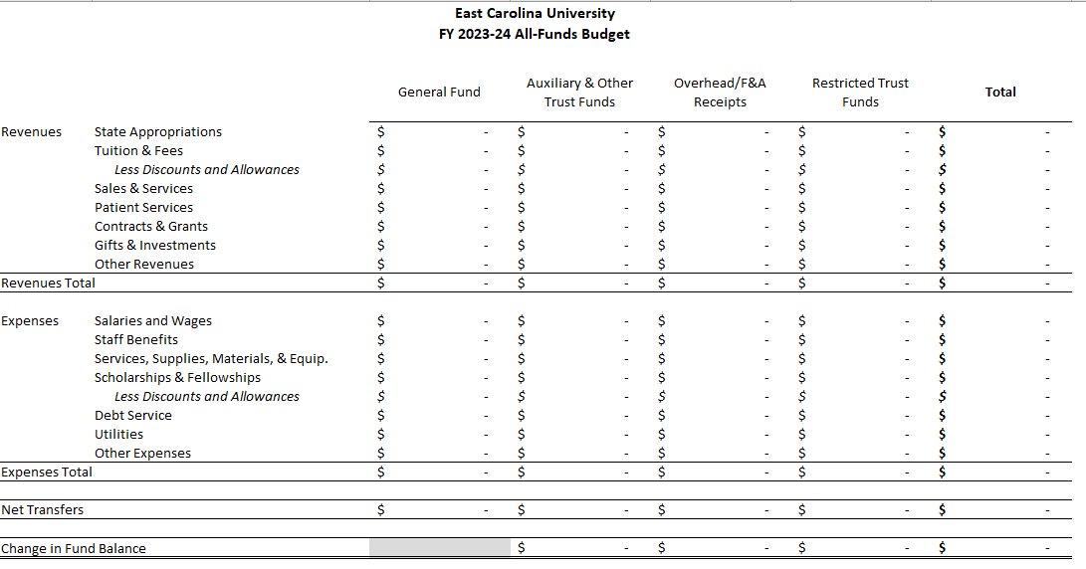
All Funds Budget Template- Summary

Slide 6
Unit Level

Slide 7
All Funds Budget – Exclusions
All funds budget focuses on operating items.
Capital-related revenues and expenses are not included; however, budgeted transfers to capital are included.
Funds that are not governed by the university are excluded (endowments, foundation funds, loan funds and agency funds).

Slide 8
All Funds Budget Anticipated Timeline
April 28, 2023 – Board of Trustees approve FY24 all-funds budget
May 25, 2023 – Board of Governors reviews budget at meeting
July 2023 – University Budget Office begins loading budgets into Banner and reconciling budgets to the All Funds Budget.

Slide 9
Student Travel
All student travel on state funds route to the Budget Office for preapproval.
Please use the comments section in Chrome River to provide as much detail as possible.
If they are a graduate assistant performing their work duties, please provide that in the comments.
If presenting research, we need to see the backup in the preapproval. Please include the page number where this backup is located in the comments.

Slide 10
Budget Office Email Changes Effective May 1st
budgetoffice@ecu.edu will be used for general inquiries for all budget questions State and ITF Funds. As a reminder, please follow your respective division process related to budget questions.
budgetofficeitf@ecu.edu will be used for Nonstate (except for Grants) position entries / approvals.
budgetoffice16066@ecu.edu will be used for Budget Code 16066 position entries / approvals.
budgetoffice16065@ecu.edu will be used for Budget Code 16065 position entries / approvals.

Slide 11
Position Control Effective May 1st
Position Control actions (People Admin, EPAF’s, and PCF’s) will route as follows:
State Budget Code 16066 – Tim Morris
ITF – Yolanda Hill
State Budget Code 16065 – Heather Taylor (no change)

Slide 12
B22 and B44 Update
Budget Entries in Self Service Banner
Nonstate funds can now use B22 and B44 rule class
Budget transfers should remain within the same fund; however, the organization code can change.
Currently, you cannot transfer from a 7 account to an 8 account, but we have a ticket in to correct this.

Slide 13
Looking Ahead
Automated negative clean up process to operating budgets on nonstate funding sources
EPAF and PCF workflows are being updated
A small workgroup is being created to include division representatives in order to develop tools to monitor budget versus actual, cash balances, and other reporting needs. Feel free to share any suggestions with your Division.

Slide 14
University Budget Office Contact Information
Dawn Quist – 737-2100
Tim Morris – 737-1131
Lisa Edwards – 737-1132
Heather Taylor – 737-1145
Laura Fanning – 737-1719
Yolanda Hill – 744-2292
Budget Office Website has many resources available.
https://budget.ecu.edu/

Slide 15
Questions?

