Slide 1
2023 ECU Financial Services Workshop
Foundation Funds Overview

Slide 2
Opening Doors Open Minds to Foundation Funds

Slide 4
www.give.ecu.edu

Slide 5
FY2022 Foundation Highlights
ECU Foundation
ECU M&HS Foundation
Total assets - $196 million
Contributions - $12.4 million
Support provided to ECU:
Scholarships - $4 million
Other programs - $6.4 million
Total assets - $78.8 million
Contributions - $6.5 million
Support provided to ECU:
Scholarships - $1.1 million
Other programs - $1.9 million

Slide 6
Office of Gift Records
All gifts and sponsorships should be deposited through the Office of Gift Records to ensure the tax deductibility of the contribution
What documentation to send to the Office of Gift Records:
Check
Is this a gift or non-gift item?
Source of funds (donor, fundraiser, registrations, etc.)
Fund designation
Notes:
IRS Publication 463

Slide 7
Office of Gift Records
Secure lockbox in hallway
Need ONE Card to access building/suite 2200
Fill out gift records form with all necessary info
Deposit gift and form in lockbox
U-Stores for Foundation funds
Contact Robin Mayo about setting up for events - (mayoro@ecu.edu)
ecugiftrecords@ecu.edu
Notes:
IRS Publication 463

Slide 8
Foundation Expenditure Policies
Each foundation has a board-approved policy
Helps ensure that donor contributions are stewarded/used appropriately
Provides guidelines for using foundation funds, including:
Documentation requirements
Approval requirements
Payment process requirements
IRS requirements - Publications 463 & 557
Notes:
IRS Publication 463

Slide 9
Foundation Expenditure Policies
Documentation:
All invoices or receipts must provide an itemized list of expenses
Receipts/invoices from vendors must be originals
Business purpose of each expenditure must be clearly documented
Purpose must be consistent with the purpose of the fund, the mission of the Foundation, and the mission of the University
Provide other supporting documentation
Meeting/program agenda
List of attendees

Slide 10
Foundation Expenditure Policies
Approval Process:
Expenditures must be approved by the assigned fund manager or by an individual with delegated authority up to certain dollar limits
Both Foundations have delegated authority approval up to $2,500
Scholarship disbursements MUST be approved by the fund manager (no delegation allowed)
Certain situations may require additional levels of approvals
ALL expenditures are reviewed and approved by the Financial Services teams at the respective foundation

Slide 11
Foundation Expenditure Policies
Payment Process:
Foundations utilize the University’s payment processes and follow its requirements to the extent possible
Accounts Payable
Payroll (for employee awards and moving expenses)
Financial Aid (for student awards/scholarships)
ProCard
Use of personal credit/debit cards and reimbursements should be the last option for payment methods

Slide 12
Foundation Expenditure Policies
Questions to Ask Yourself:
Do you have funds available?
Does the expenditure meet the purpose of the fund you intend to use?
Is this expenditure reasonable and prudent?
“Newspaper test” - would be comfortable with the expenditure and amount being made public?
Has the fund manager (or designee) approved the use of funds?
Do you have all of your supporting documentation for the expenditure?
Does the expenditure comply with University policies?

Slide 13
Common Foundation Expenditures
University-related travel
Event expenses
Moving expenses
Business meals
Non-University guests MUST participate
Entertainment
Non-University guests MUST participate
Tips (up to 20%)
Awards to employees
Awards/gifts to non-University personnel
Residents
Research participants
Retirement awards/gifts
Flowers
Notes:
Other items to consider….

Slide 14
Prohibited Foundation Expenditures
Contributions to other 501(c)(3) entities
Expenses for personal benefit
Purchase or rental of clothing (excluding performance costumes)
Parking permits for University employees
Political contributions
Fines
Birthday or going-away parties
Gifts represented as being from an individual
Lavish expenditures
Notes:
Other items to consider….

Slide 15
ProCard & Foundation Funds
Follow all ProCard policies and procedures
Documentation requirements DO NOT change when using ProCard
Does the expenditure meet the purpose of the fund?
Is this expenditure reasonable?
Do you have fund manager approval?
Do you have funds available?
Allocate your charges appropriately – if you are not sure about a FOAP...ASK
Upload all supporting documentation in Chrome River
Notes:
Other items to consider….

Slide 16
Scholarships
Annual contribution deadline for scholarship funding cycle is 12/31
When can we expect funding information from Foundations?
Initial information provided around 12/1 for planning purposes
Final funding availability provided mid-January
What to consider when deciding how much to award
Annual endowment spending rate (if applicable)
Is this a multi-year scholarship commitment?
Does the scholarship have a defined award amount or minimum?
Notes:
Other items to consider….

Slide 17
New Foundation Funds
Want to set up a new fund?
Contact the foundation office to discuss requirements and purpose
New fund minimums:
Endowment funds – $25,000
Current-use funds (‘A’ or ‘T’) - $5,000
If requirements are not met, the foundations reserve the right to close the fund and move monies to another appropriate fund
Notes:
Other items to consider….

Slide 18
Decoding the Fund number
Fund types and uses:
First letter indicates the foundation (E = ECU Foundation, M = M&HSF, A = Alumni, P = Pirate Club)
Second letter indicates fund type
A – Annually funded (spendable) C – Endowment corpus (non-spendable)
T – Temporarily restricted (spendable) R – Endowment earnings (non-spendable)
E – Endowment expendable (spendable)
Example Fund numbers
ME7680 = ECU M&HS Foundation endowment expendable fund (will have a corresponding C&R)
EA5620 = ECU Foundation annually funded (typically scholarship funds)
Notes:
Other items to consider….

Slide 19
Foundation Funds & Banner
Do NOT use Self Service Banner for foundation funds
Banner 9 is the preferred method for accessing foundation fund information
Firefox or Chrome work best with Banner 9
Quick queries (ODS based) are available on the Systems Coordination website
www.ecu.edu/syscoord/
Notes:
Other items to consider….

Slide 20
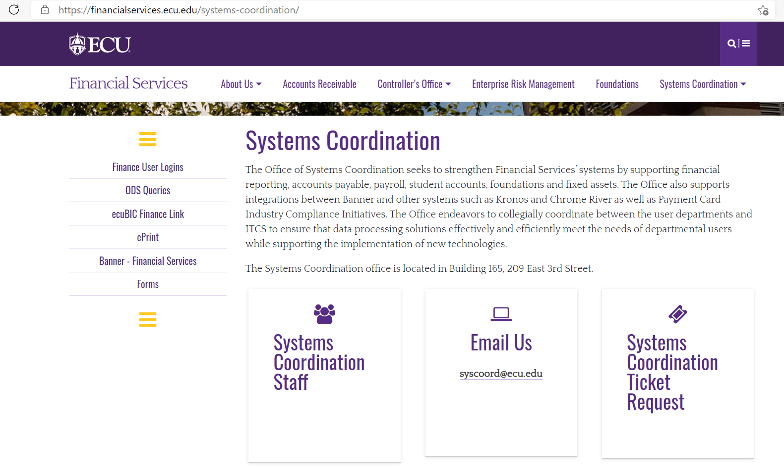
Systems Coordination Quick Queries www.ecu.edu/syscoord
Notes:
Other items to consider….

Slide 21
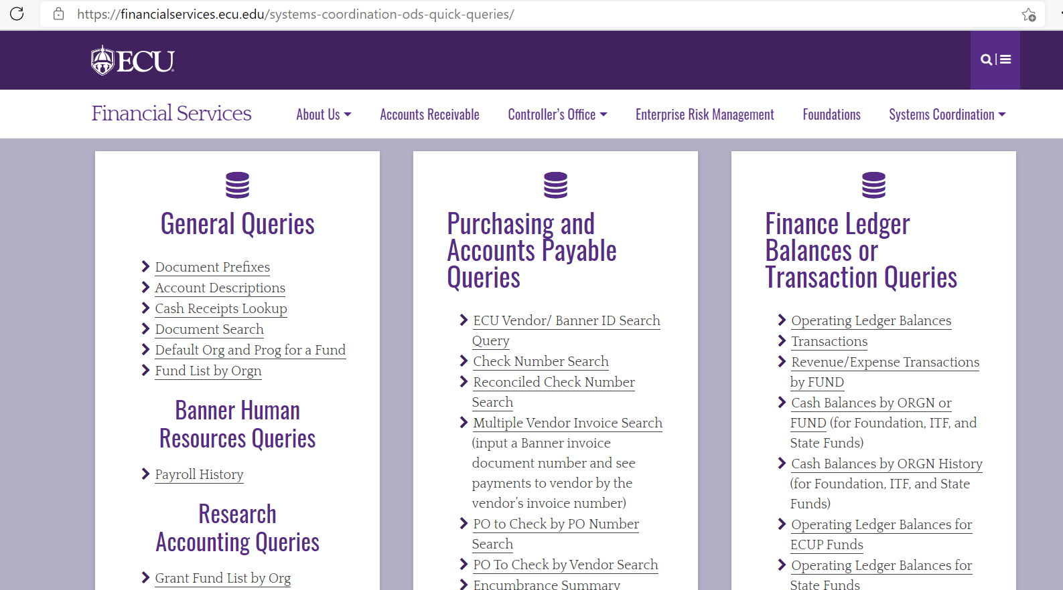
Systems Coordination Quick Queries www.ecu.edu/syscoord
Notes:
Other items to consider….

Slide 22
Banner 9
Notes:
Other items to consider….

Slide 23
Fund Balance - FGITBSR
Revenues
Expenses
Current
Fund Balance
Notes:
Other items to consider….

Slide 24
Transaction Summary - FGIBDST
YTD Activity
** NOTE: Revenue lines total to “Revenue Control” on FGITBSR
Expense lines total to “Expense Control” on FGITBSR
Notes:
Other items to consider….

Slide 25
Transaction Detail - FGITRND
Notes:
Other items to consider….

Slide 26
Transaction Detail - FGITRND
Notes:
Other items to consider….

Slide 27
Transaction Detail - FGITRND
Notes:
Other items to consider….

Slide 28
Transaction Detail – Excel Worksheet
Notes:
Other items to consider….

Slide 29
Questions?
Notes:
Other items to consider….

Slide 30
Contacts – ECU Foundation
Vacant, Controller
Heather Wiggins, Accountant
gardnerh@ecu.edu or 737-5369
Mark Sarfo, Accountant
sarfom22@ecu.edu or 328-9574
Candi High, Accountant (Alumni)
highc@ecu.edu or 328-0604
Tonya Jones, Administrative Support Specialist
wilsonto@ecu.edu or 328-9553
Notes:
Other items to consider….

Slide 31
Contacts – ECU M&HS Foundation
Joel Stocks, Controller
stocksj15@ecu.edu or 744-2068
Mandy King, Accountant
kinga@ecu.edu or 744-2170
Tracy Gilland, Administrative Support Specialist
gillandt@ecu.edu or 744-3765
Notes:
Other items to consider….

