Slide 1
Institutional Trust Funds Overview
East Carolina University Financial Services, MS 203 Greenville Centre
2200 Charles Blvd

Slide 2
ITF Staff
Mary Ann Hunter, CPA
737-1138
huntermary15@ecu.edu
New Fund Requests, JVEs, Spending Questions/Approvals
Debra Bailey, CPA
737-4916
Accounting Manager, Financial Statements
Arturo Aguilar
737-1143
bechtela16@ecu.edu
Payroll Redistributions, JVEs, Spending Questions/Approvals
Vacant
JVEs, Endowments, Scholarships, Distinguished Professorships

Slide 3
What are Institutional Trust Funds?
Are established at the University level by authority of Chapter 116, Article 1 of the General Statutes
Are set up for specific business purposes as determined by the approved Fund Authority, and in compliance with UNC-FIT and University guidelines
Are NOT state appropriated
Are NOT for personal benefit
G.S. 116-36.1

Slide 4
Types of Institutional Trust Funds
All numbered funds except:
11 (state), 15 & 21 (grants), 314 & 315 (ECUP) A, E, M (foundations)

Slide 5
Overhead/F&A Funds
Begin with 12xxxx
Indirect cost earned from grants
50412 - Grant and Contract F&A Distribution
58259 – Indirect Cost Transfer (overhead to overhead)
Expenditures must be research related
Established at college or division level

Slide 6
Institutional Trust - General
Begin with 13xxx – 14xxxx (not 143xxx)
All expenses must be in accordance with approved fund authority form, University policies, and UNC-FIT guidelines
Examples
Student activity programs
Fees for services (i.e. registration, training, etc.)
Royalties, patents, copyrights

Slide 7
Institutional Trust - Residual Funds
Begin with 143xxx
143xxx are residual balances transferred from grants
Revenue/Income should only show in account code 58253 - Nonmandatory Restricted
No other funding should be deposited or transferred into these funds
Expenditures must be research related
Established at college or division level

Slide 8
Auxiliary Funds
Begin with 31xxxx
Includes student auxiliaries, institutional auxiliaries, and service center operations
Self-supporting entities
Examples
Parking and Transportation
Student Health Center
Housing and Dining
Student Stores

Slide 9
Restricted Trust Funds
Must be used only for the donor-restricted purpose
Restricted Trust Funds begin with 23, 24, 25, 27
23 - Scholarships
24 - Professorships
25 - Departmental Use
27 - Other Restricted
Restricted Endowments begin with 2E, 6C, 6Z, 6R
3 parts: Corpus (6C or 6Z), Restricted (6R), Spendable (2E)
Corpus and Restricted Funds cannot be spent
Principal is invested and interest earned is allocated annually to the spendable fund in accordance with ECU’s endowment policy.

Slide 10
Agency Funds
Begin with 8xxxxx
Funds Held for Others
Use account 26500 “Funds Held for Other Noncurrent” for all transactions including revenue deposited.
If ProCard is used, prepare a Journal Entry monthly to moved expenses to 26500.

Slide 11
Operation and Use of Trust Funds
Need to maintain a positive cash balance
Must be used as documented on the approved Fund Authority
Must follow ECU spending guidelines, and comply with UNC-FIT and the General Statutes
Requires VC approval to establish
Changes in scope, purpose, source of revenue, organizational code, etc. must be reported to the ITF Office
Requires an updated Fund Authority
A new fund may be required

Slide 12
DocuSign –Fund Authorities
DocuSign will allow departments to create and revise Fund Authorities electronically
Approvers can access the forms through their e-mail and provide their electronic signature
This will reduce the time it takes to complete these documents and the documents can be signed from anywhere with email access
Fund Authority forms are located on the ITF website.
Training video available in CornerStone

Slide 13
https://financialservices.ecu.edu/itf-overview/

Slide 14
https://financialservices.ecu.edu/establishing-an-itf/

Slide 15
https://financialservices.ecu.edu/forms-reports-and-training-accounting-services/

Slide 16
*Banner security access may be required to view this report

Slide 17
Use Banner 9 Admin Pages to view ITF fund activity
Self Service Banner is not recommended for ITF funds!

Slide 18
Helpful Banner 9 Screens
FGITBSR – Trial Balance Summary
-This screen will list every transaction that impacts the fund.
FGIBDST – Organization Budget Status
-This screen shows the adjusted budget as well as the actual cash revenue and expense transactions.
FGITRND - Detail Transaction Activity
-Looks up transactions with various query filters
*Click on account code, press F3 to drill down for further details

Slide 19
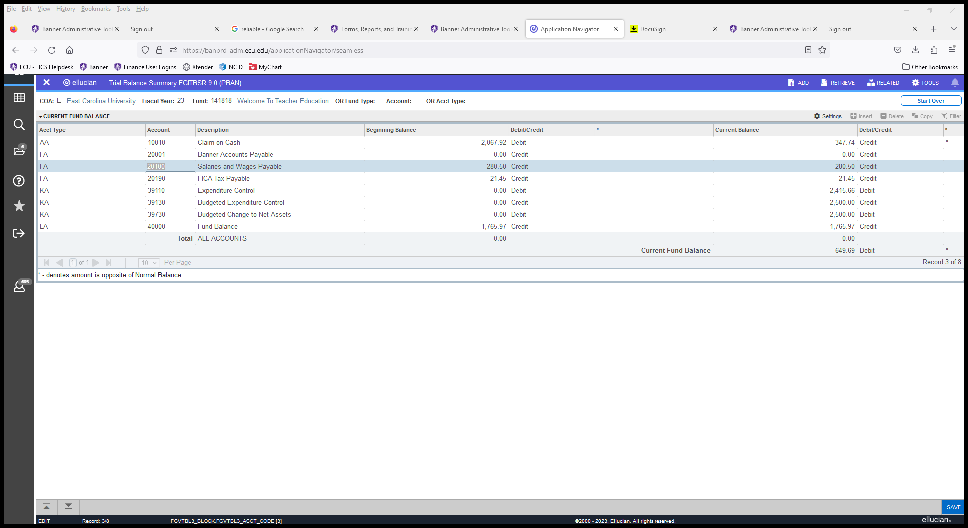
FGITBSR screen – Use current balance column.
Expenditure control = expenses

