Slide 1

Chrome River Training Penney Doughtie, Trainer January 29, 2020

Slide 2
Slide 3 What is Chrome River?
Slide 4 Travel and ProCard Policies
Slide 5 Chrome River Timeline
Slide 6 What security access is needed Chrome River?
Slide 7 What training is needed for Chrome River?
Slide 8 How to Access Chrome River?
Slide 9-10 Chrome River Dashboard
Slide 11 Chrome River Pre-Approval Report and Expense Report Types
Slide 12 Naming Conventions on Report Header
Slide 13 Tracking Pre-Approval Reports and Expense Reports
Slide 14 Report Status Definitions
Slide 15 Three Types of ProCard Reconciliation
Slide 16 Instructions to Upload Attachments
Slide 17 Instructions to Add Attachments
Slide 18-25 Instructions to Reconcile ProCard Non-Travel Transactions
Slide 26-30 Instructions to Create Non-Travel Reimbursement (formerly Direct Payment)
Slide 31-43 Instructions to Create Pre-Approval Report
Slide 44-59 Instructions to Create Travel Expense Report and Reconcile ProCard Travel Transactions
Slide 60-65 Instructions to Reconcile ProCard Transactions for Candidate or Group Purchase
Slide 66-67 Expire Unused Pre-Approval Report Balance
Slide 68-75 Instructions to Create Blanket Travel Pre-Approval Report
Slide 76-80 Instructions to Create Blanket Travel Report to Reimburse Employee
Slide 81-85 Approval Process
Slide 86-87 Assign Approver Delegate
Slide 88 Chrome River Miscellaneous Processes
Slide 89 Encumbrance Process
Slide 90 Correction Process
Slide 91 Process Personal ProCard Transactions
Slide 92 Assign Delegates to submit on one’s behalf
Slide 93 View Pre-Approval Reports and Expense Reports Older than 90 days
Slide 94 Chrome River Team Dynamix Ticket Request
Slide 95 Chrome River Training Resources
Slide 96 Chrome River Contact Information
Slide 97-100 Chrome River Glossary
Slide 101 Banner Document Descriptions

Slide 3
What is Chrome River?
Chrome River is an accounting software application designed to automate and streamline Accounts Payable processes for travel expenses and corporate credit card transactions. This software product is designed to incorporate University travel rules and automate the approval processes.
Chrome River will replace the Online Travel system and the current ProCard reconciliation process in WORKS.
Chrome River will include ProCard transactions and reimbursements to those with a PirateID; including employee and student travel reimbursement, and employee non-travel reimbursement. ECU employees, students, residents, fellows, and dental students have a Pirate ID.
Chrome River will not include travel reimbursement to candidates and non-employee reimbursements. These payments will be processed using the manual Travel Authorization / Reimbursement for Travel Form. Non-travel reimbursements will be processed using the Direct Payment Form.
For more information watch Chrome River Office Video: Intro to Chrome River

Slide 4
Travel and ProCard Policies
Chrome River will not change the Travel and ProCard Policies mandated by ECU and the State of North Carolina.
Chrome River will automate the approval routing process and electronically route the required approvals for ProCard Transactions, Non-Travel – Employee Only (formerly Direct Payments), Pre-Approvals and Travel Reimbursements.
All required documentation is needed to follow current policies; however, it will be scanned.
Chrome River will replace the paper documentation with electronic copies. The documentation can be viewed in Chrome River(see slide #4).

Slide 5
Chrome River Timeline
GO LIVE , TBA
Travel
Pre-Approvals and Expense Reimbursements for TBA Travel Dates can be processed in the current online system.
Pre-Approvals for TBA Travel Dates can be used by scanning the Pre-Approval documentation and attaching the file to the Chrome River Expense Report.
Expense Reimbursements for TBA Travel Dates will be processed in Chrome River.
Pre-Approvals and Expense Reimbursements for TBA must be processed in Chrome River.
ProCard
ProCard transactions posted TBA and before will be reconciled in the current online travel system using WORKS and a paper statement.
ProCard transactions posted TBA and after will be processed in Chrome River.
Blanket Travel
Beginning TBA create Pre-Approval Reports for Blanket Travel in Chrome River.
Blanket Travel in current online systems is valid thru TBA.
Blanket Travel beginning TBA and forward will be processed in Chrome River.

Slide 6
What security access is needed for Chrome River?
All ECU employees will have access to Chrome River using the single sign on credentials (PirateID and Passphrase).
No Banner Finance security is required.
Chrome River has no ORGN security.

Slide 7
What training is needed for Chrome River?
Online ECU Banner Finance Training for New Users. Register on Cornerstone.
Online ProCard Training. Register on Cornerstone.
Chrome River Training. Register on Cornerstone.
The Chrome River Office has created a video library with more than 25 travel and ProCard topics for end users.

Slide 8
How to access Chrome River?
Chrome River login is located in Pirate Port.
Single Sign on credentials will be used for Chrome River (PirateID and Passphrase).
FireFox is the best Web Browser for Chrome River.

Slide 9
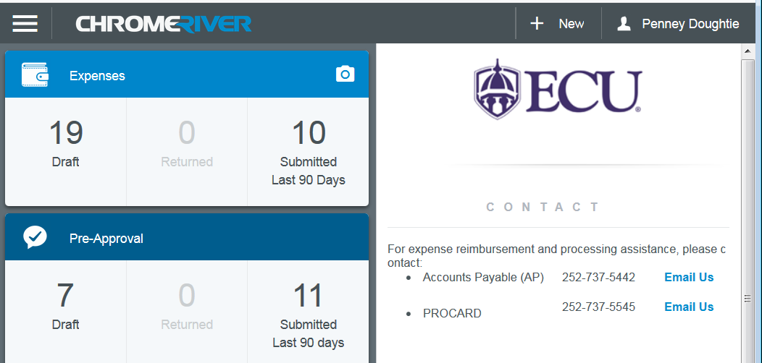
Chrome River Dashboard

Slide 10
Chrome River Dashboard
Upper right corner of the Chrome River navigation bar displays the user name.
  To select another delegate Click Name in right corner to view dropdown list with delegate names
  Settings
  Help – this link has video task instructions created by Chrome River that provides brief step by step instructions
Dashboard Left side displays
  Expenses – Non-Travel and Travel
  PreApprovals
  Approval Queue
Dashboard Right side displays
  Contact Information, Helpful Tips
Click the menu icon in the upper left corner of the Chrome River navigation bar.
  eWallet, eReceipts, Drafts, Returns, Recently Submitted
  Chrome River Office Video: In depth Video Orientation Start at 2:30
Notes:
https://app.ca1.chromeriver.com/login

Slide 11
Chrome River Pre-Approval Report Types
Pre-Approval Travel – Employee - replaces Travel Authorization in the current Online Travel Request System (Slides 26-30)
Pre-Approval Blanket -replaces Blanket Travel in the Travel Request System (Slides 68-75)
Chrome River Expense Report Types
ProCard Reconciliation – this expense type replaces the monthly reconciliation in WORKS. This process is for ProCard transactions that are Non-Travel Transactions (example: supplies, services, utilities, etc.). (Slides 18-25)
ProCard Travel Reconciliation – this expense type is used for Non-Employee travel. A ProCard holder purchased an airfare for a candidate. Also used if purchasing multiple expenses on one transaction for employees (example: conference fees for five employees $500/person, receipt $2,500.). (Slides 60-65)
Non-Travel - Employee Only – this expense type replaces the Direct Payment Form for non-travel reimbursement to employees, including students, residents, fellows, and dental students. Payments to non-employees will continue to use the Direct Payment Form. (Slides 26-30)
Travel – Employee - replaces Post Travel in the current Online Travel Request System. This is the reimbursement process. (Slides 44-59)
Travel - Blanket - replaces Blanket Travel in the current Online Travel Request System. This is the reimbursement process. (Slides 76-79)

Slide 12
Naming Conventions on Report Header
- Standard Report names to assist in reporting
- Assists with quick reviews/searching thru historical records
- Report names tell a “story” without opening full report
ProCard Reconciliation PC.Cardholder Name.End Date
PC.Hopper.Steven.10.31.2019
ProCard Travel Reconciliation PCT.Cardholder Name.End Date
              PCT.Hopper.Steven.11.15.2019
Pre-Approval Blanket Travel BL.Name of Traveler.Months Covered Under Blanket
BL.Hopper.Steven.Nov-Jun
Pre-Approval Travel Employee TE.Name of Traveler . Date of Departure. Destination
    TE.Hopper.Steven.11.19.2019.Tampa.FL
Non-Travel-Employee Only NT.Name of Expense Owner. Date of Receipt/Expense
    NT.Hopper.Steven.11.01.2019
Travel Student TS.Name of Student.Date of Departure. Destination
    TS.Smith.John.11.01.2019.Dallas.TX
Travel Study Abroad TSA.Name of Traveler. Date of Departure. Destination
    TSA.Jones.Sarah.11.01.2019.Belgium

Slide 13

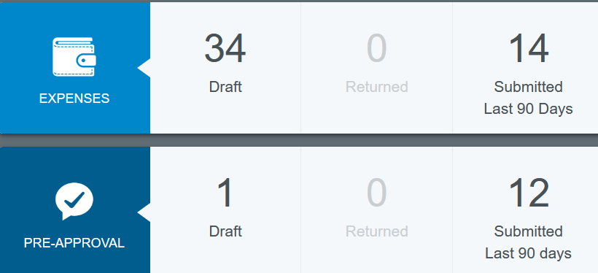
Tracking Pre-Approval Reports and
Expense Reports in Chrome River
Return to the Chrome River Dashboard by clicking
Click on the number to view the list of Expenses or Pre-Approvals (in this example, click 14)
Click the desired Expense Report
  One Click displays Report Owner, ID#, Approvers, Expense Summary, Account Summary, Comments, Attachments
Click the Tracking button to view the report status and the person currently assigned in the automated approval process
If an Expense Report or Pre-Approval Report needs to be “RECALLED”, use these directions to locate the report and click “RECALL.” Expense Report or Pre-Approval Report can only be “Recalled” while in the “Pending” status. “RECALL” is not available after the status changes to Approved.
***Note: After ninety days, view My Expense Reports in the Inquiry section (see slide #93).

Slide 14
Report Status / Definitions
Pre-Approval Report Status
Pending – Pre-Approval Report has been submitted and is awaiting approval.
Approved - Pre-Approval Report has been approved and is deducted from the budget in Banner as an Encumbrance.
Partially Applied - Pre-Approval Report has had at least one expense report charged.
Used/Expired - Pre-Approval Report is complete and any unused balance has been liquidated and added back to the designated FOAP budget.
Expense Report Status
Pending – Expense Report has been submitted and is awaiting approval.
Approved - Expense has been approved but has not yet been exported.
Exported - Expense has been sent to the payment process in Banner.
Paid - Expense has been reimbursed.
Partially Paid – Part of the requested expense amount has been reimbursed.

Slide 15
Three Types of ProCard Reconciliation
Important: All ProCard Transactions must be expensed within 30 days of the purchase or the ProCard could be suspended. This includes travel transactions that will be moved to the traveler’s eWallet. The traveler, or delegate, must complete a travel expense report to expense the ProCard charges within 30 days from the transaction date.
Non-Travel ProCard Transactions
  Create a New Expense report
  Report Type is Pro-Card Reconciliation
  Step by Step Instructions on slides 18 – 25
Travel ProCard Transactions for Employees
  Travel expenses purchased on a ProCard must be applied to a Pre-Approval Report, because employee travel expenses are required to have a Pre-Approval Report
  Create a New Expense report
  Report Type is Travel - Employee
  Import the Pre-Approval Report
  Step by Step Instructions on slides 44 – 59
Travel ProCard Transactions for Non-Employees or a Group of Employees
  Travel expenses purchased on a ProCard for Non-Employee travel do not require a Pre-Approval Report (example: ProCard holder purchased an airfare for a candidate) or multiple expenses purchased on one ProCard transaction (expample: conference fees for five ECU employees $500/person, receipt $2,500.)
  Create a New Expense report
  Report Type is ProCard Travel Reconciliation
  Step by Step Instructions on slides 60-65

Slide 16
Upload Attachments to Chrome River
Attachments includes: receipts, registration information, maps, fliers, invitations, emails, agendas, participation lists, Third Party Lodging Agreements, late memos, Pre-Approval Memos, Extended Stay Travel/Combined Personal and Business Travel Forms, and any other backup information or supporting documentation.
Use caution when scanning attachments to ensure that no confidential information is scanned. Redact credit card info, research participant names, etc.
Attachments must be formatted as pdf, jpeg, png, or tif.
Upload Attachments
Use CR SNAP Application to scan/upload/store the attachments in the CR Receipt Gallery
Scan attachments using a copier and upload to the CR Receipt Gallery
Scan attachments using a copier and store on a PC
Notes:
https://app.ca1.chromeriver.com/login

Slide 17
Add Attachments to PreApproval/Expense Report
Pre-Approval Report
Go to the Chrome River Dashboard
Click the Pre-Approval Submitted Number
Click the desired Pre-Approval Report Title
Scroll to the bottom
Click Upload Attachments
Locate and select the desired Attachment
Expense Report
Click Add Attachments located at the bottom of every expense category
Click From Receipt Gallery or Upload Attachments
Locate and select the desired Attachments
Click Save
Upload from Receipt Gallery Instructions
Click Add Attachments
Select From Receipt Gallery
Select Attachment
Click Attach
Click Save
Upload from Computer instructions
Click Add Attachments
Select Upload Attachments
Select File Name (must be pdf, jpeg, png, tif)
Click Open
Click Save

Slide 18
Instructions to Reconcile ProCard Non-Travel Transactions

Slide 19
When and how often will the ProCard reconciliation be done for Non-Travel transactions?
The ProCard reconciliation process can be started/submitted throughout the month
It depends on the quantity of ProCard transactions
A helpful tip, the reconciliation process can be started and held in the “Draft” queue until all transactions are completed and submitted
At least monthly or 20 – 25 ProCard transactions per Expense Report is a good practice; also, consider the approver
Automated reminder emails will be sent

Slide 20


Slide 21

Create Expense Report Header for
ProCard Non-Travel Transactions
Verify that the correct ProCard Holder’s name is listed in the top right corner
Click the plus NEW (top right)
Click New Expense Report
Enter Report Name (slide 12) on the Report Header
(PC prefix to identify as ProCard, cardholder’s last name, first name, end date) example: PC.Doughtie.Penney.11.15.2019
Select Pro-Card Reconciliation from the Report Type dropdown
Select Non-Travel from the Travel Type dropdown
Click Save in top right corner
***Note: Expense Report number is created and displayed in the bottom left corner.

Slide 22
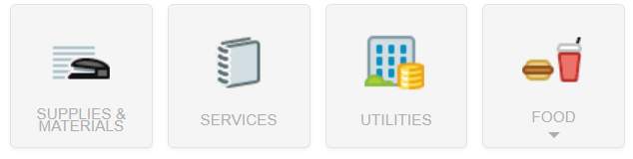
Add Expenses for
ProCard Non-Travel Transactions
Click Credit Card
Select the desired transactions
Click Add
Select Valid Expense type ***Note: Date and Amount will populate.
Enter detailed Business Purpose
If needed, enter description and attendees
Select Account from the dropdown list
Allocation Section
  Select FUND and ORGN from the dropdown list
  Select Non-Travel from the Expense Type dropdown list
  Select Activity code if applicable: select N/A if no Activity code is needed
Add Attachments (see slide 16-17)
Click Save

Slide 23
Label ProCard Transaction as Personal Expense
A ProCard holder should never charge a personal expense on an ECU ProCard; however, if this inadvertently occurs, the personal transaction should be assigned as follows:
Assign the personal expense to the correct category (supplies, services, etc.)
Click the Appropriate Tile
Apply Personal ProCard Transactions
Select the expense type
Enter Amount, Description, Required Info
Use FUND/ORGN/PROG to 140299-230606-0000 - this transaction will not reflect in the departmental budget. The personal ProCard transaction will be tracked as a receivable in FOAP 140299-230606-12451-0000
Add Attachments (see slides 16-17)
Click Save
***Note: The Personal Expense Amount will be collected in the ProCard Office or paid by U-Store. If payment is not received in a timely manner, the ProCard could be suspended.
Notes:
https://app.ca1.chromeriver.com/login

Slide 24

Edit/View the Expense Report
The Expense Report will be listed on the Chrome River Dashboard in the Draft Section until the final Submit Process is complete
To View the Expense Report
  Go to the Chrome River Dashboard
  Click the Draft Number/Title
  Select the Desired Expense Report
  Click Open
To Add more ProCard transactions to the Expense Report, Click
Repeat the steps in slide 22
Multiple ProCard transactions can be added to an Expense Report and held as a Draft until the expense report is submitted. Click Save and the Expense Report will be held in Draft column on the Chrome River Dashboard
After all ProCard transactions have been selected for the expense report, complete the Submit process on slide 25

Slide 25
Submit after all ProCard Non-Travel transactions are added to the Expense Report
After all ProCard transactions have been selected for the billing cycle, Click Submit
Click Submit for Confirmation
The Expense Report will be listed on the Chrome River Dashboard in the Submitted Section
After the Expense Report is submitted, the automated approval routing process begins as follows:
  Expense Owner Approval (ProCard Holder)
  HR Supervisor Approval
  Approval routing based on the business rules built into Chrome River
  Approval by the Chrome River Office Staff
  Transaction feeds to Banner nightly
Automated emails will be sent after each level of approval. Within the email will be a link for the approver to open and view the Pre-Approval Report or Expense Report. The approver can approve the Chrome River request within the email.
To Track/View the Approval Process, see slide #13.

Slide 26
Instructions to Create Non-Travel Reimbursement

Slide 28
Create Expense Report Header for Non-Travel-Employee Only Reimbursements
This process replaces the Direct Payment for employees. A user can create a Non-Travel Employee Only Reimbursement for themselves or the delegates in the list.
Verify that the correct Employee name that is due reimbursement is listed in the top right corner
Click the plus NEW (top right)
Click New Expense Report
Enter Report Name (NT prefix to identify the Non-Travel Expense Report type, cardholder’s last name, first name, receipt date) example NT.Doughtie.Penney.11.18.2019
Select Non-Travel - Employee Only from the Report Type dropdown
Select Non-Travel from the Travel Type dropdown
Click Save
***Note: Expense Report number is created and displayed in the bottom left corner.

Slide 29
Add Expenses for Non-Travel
Employee Only Reimbursements
Click Create New
Select Valid Expense type
Enter the Transaction Date
Enter the Transaction Amount
Enter a detailed Business Purpose
If needed, enter Description
Select Account from the dropdown list
Allocation Section
  Select FUND and ORGN from the dropdown list
  Select Non-Travel from the Expense Type dropdown list
  Select Activity code if applicable; select N/A if no Activity code is needed
Add Attachments (see slides #16-17)
Click Save

Slide 30
Submit after all transactions are added to the Expense Report
After all transactions are added to the Expense Report, Click Submit
Click Submit for Confirmation
The Expense Report will be listed on the Chrome River Dashboard in the Submitted Section
After the Expense Report is Submitted, the automated approval routing process begins as follows:
  Expense Owner Approval
  HR Supervisor Approval
  Approval routing based on the business rules built into Chrome River
  Approval by the Chrome River Office Staff
  Transaction feeds to Banner nightly
Automated emails will be sent after each level of approval. Within the email will be a link for the approver to open and view the Pre-Approval Report or Expense Report. The approver can approve the Chrome River request within the email.
To Track/View the Approval Process, see slide #13.

Slide 31
Instructions to Create New
Pre-Approval Report

Slide 32
Purpose of the Pre-Approval Report
Preauthorize an ECU employee to travel
Approve the estimated travel amount
Approve the FOAPAL used
Encumber (deduct) the estimated travel amount in the departmental budget

Slide 34
Create Pre-Approval Report Header
Verify that the correct Employee Traveler’s name is listed in the top right corner
Click the plus NEW (top right)
Click New Pre-Approval Report
Enter Report Name (TE prefix to identify as Travel Expense, traveler’s last name, first name, travel departure date, destination city)
example: TE.Doughtie.Penney.11.28.2019,Gum.Neck.NC
Enter Travel’s Start Date and End Date
Enter a Business Purpose Description
Select Report Type from the dropdown (Employee, Blanket, Athletics, etc.)
Select Travel Type from the dropdown (In-State, Out-of-State, etc.)
Select Destination from the dropdown list
Select YES from the dropdown list “Excess Lodging Authorized”
Allocation Section
  Select FUND and ORGN from the dropdown list
  Select In-State, Out-of-State, etc. from the dropdown list
  Select Activity code if applicable; select N/A if no Activity code is needed.
Click Save
***Note: Pre-Approval Report ID is created and displayed in the bottom left corner.

Slide 35
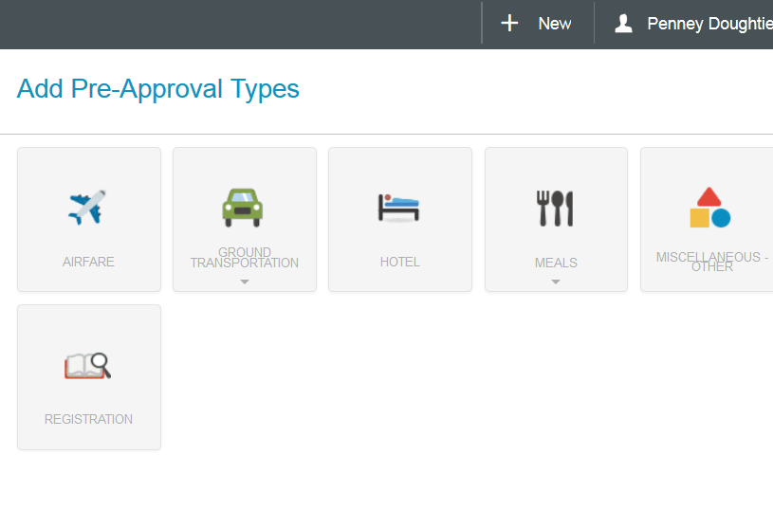
Add estimated expenses to the Pre-Approval Report
Pre-APPROVALS WILL BE ENCUMBERED WHEN APPROVED!
NEED BEST ESTIMATES.

Slide 36
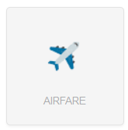
Add Airfare
Estimated Cost
Click the Airplane Tile
Enter Estimated Amount
Add a Description
Select Airline from the dropdown list
Click Save
Notes:
https://app.ca1.chromeriver.com/login

Slide 37
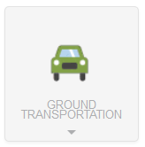
Add Ground Transportation Estimated Cost
Click the Ground Transportation Tile
Select the expense type
Enter Estimated Amount
Add a Description
Click Save
Notes:
https://app.ca1.chromeriver.com/login

Slide 38
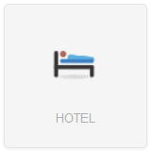
Add Hotel
Estimated Cost
Click the Hotel Tile
Select the expense type
Enter Estimated Amount
Add a Description
If this is 3rd Party Lodging, select Yes and attach the approved 3rd Party Lodging Pre-Approval for Reimbursement Form
Click Save
***NOTE: “YES” should be selected for all lodging regarding Exceeds amount of state contract on the Pre-Approval Report Header Page.
Notes:
https://app.ca1.chromeriver.com/login

Slide 39
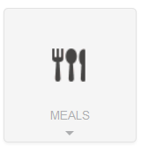
Add Meals
Estimated Cost
Click the Meals Tile
Select the expense type
Enter Required Cells
Click Save
Notes:
https://app.ca1.chromeriver.com/login

Slide 40
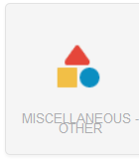
Add Miscellaneous Other
Estimated Cost
Click the Miscellaneous -Other Tile
Enter Estimated Amount
Enter Description
Click Save
Notes:
https://app.ca1.chromeriver.com/login

Slide 41
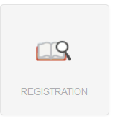
Add Registration
Estimated Cost
Click the Registration Tile
Enter Estimated Amount
Enter Description
Click Save
Notes:
https://app.ca1.chromeriver.com/login

Slide 42
Add Supporting Documentation to the Pre-Approval Report
Click on the Pre-Approval Report Title (exp. TE.Doughtie.Penney.11.28.2019,Gum.Neck.NC)
Scroll to the bottom
Click Upload Attachments (see slides #16-17)
Pre-Approval Travel Documents:
  Departmental Approval
  Registration documentation, itineraries, invitations, etc.
  Airline documentation
  Hotel Reservation Confirmation
  Other related travel documents

Slide 43
Submit after all estimated expenses are added to the Pre-Approval Report
After all Pre-Approval estimated expenses have been added, Click Submit
Click Submit for Confirmation
The Pre-Approval Report will be listed on the Chrome River Dashboard in the Submitted Section
After the Pre-Approval Report is Submitted, the automated electronic approval routing process begins as follows:
  Traveler Approval
  HR Supervisor Approval
  Approval routing based on the business rules built into Chrome River
  Approval by the Chrome River Office Staff
  Transaction feeds to Banner nightly
Automated emails will be sent after each level of approval. Within the email will be a link for the approver to open and view the Pre-Approval Report or Expense Report. The approver can approve the Chrome River request within the email.
To Track/View the Pre-Approval Report, see slide #13
***Note: Personal Travel policies will apply as always by removing expenses related to personal days expenses. Also, attach the completed “Combined Business and Personal Travel Memo” located on the Travel Office Website.

Slide 44
Instructions to Create Travel Expense Report and Reconcile ProCard Travel Transactions

Slide 46
Create New Expense Report for Post Travel
Verify that the correct Employee Traveler’s name is listed in the top right corner
Click the plus NEW (top right)
Click New Expense Report
Click Import Pre-Approval
Select the Pre-Approval Report from the dropdown
Click Import
Select Travel - Employee from the Report Type dropdown
Enter Travel Date in the Departure Date Cell and Return Date Cell
Enter Travel Time in the Departure Time Cell and Return Time Cell
Verify Travel Type
Verify Destination
Click Save
***Note: Expense Report ID is created and displayed in the bottom left corner.

Slide 47
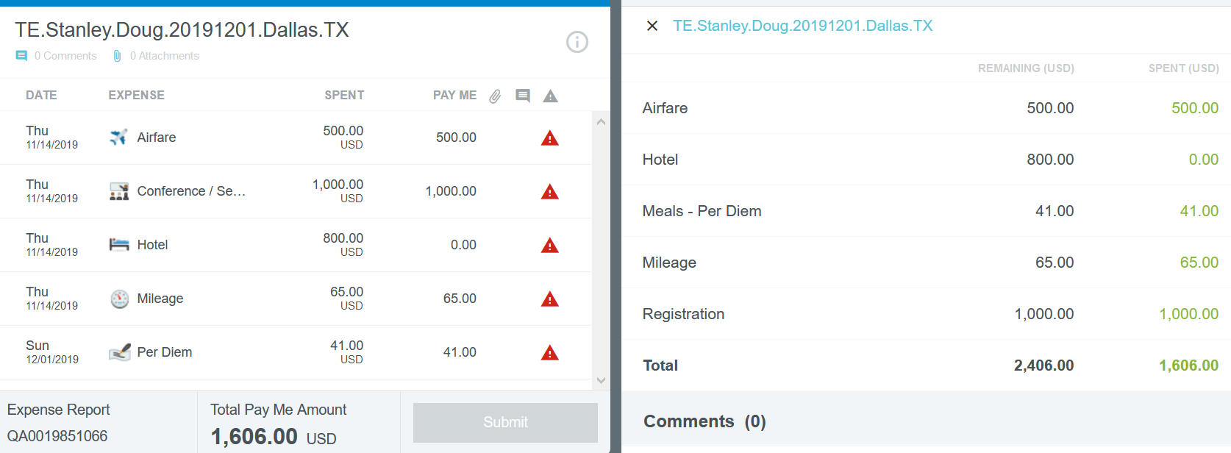
The imported Pre-Approval Report lists the estimated expenses, with a red triangle.
Each transaction requires validation (enter required info, verification of populated FOAPAL, and attachments). After the required information is provided, a green check is displayed.
Note: The hotel transaction shows a zero balance because Chrome River requires all hotel expenses to be itemized in addition to the attachment and FOAPAL.

Slide 48
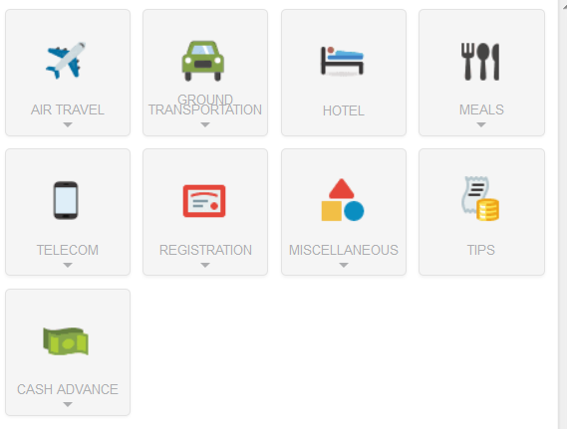
Validate Travel Expenses
Select the expense type
Apply ProCard Transactions
Enter Amount, Description, required info
Verify Allocation (FOAPAL) is correct
Add Attachments (slides #16-17)
Click Save
***Note: Mileage is calculated on the official NC state rate. If the exempted rate is approved, (mostly for 314/315 Funds) create a Miscellaneous Expense for the difference. Example: Dr A has 120 miles for a trip.
Exempted Rate 120 miles @.58 miles = $69.60
NC State Rate 120 miles @.33 miles = $39.60
Difference $30.00
Two Expenses
Ground Transportation – $39.60
Miscellaneous – $30.00
Notes:
https://app.ca1.chromeriver.com/login

Slide 49
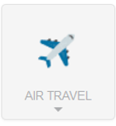
Add Air Travel Expense
APPLY PROCARD TRANSACTIONS
  Click Credit Card
  Drag and drop
  Enter Required Info
  Verify Allocation (FOAPAL) is correct
  Add Attachments (slides #16-17)
PROCESS REIMBURSEABLE EXPENSES
  Click the Expense Type (Airfare, Baggage Fee, Change Ticket Fee)
  Enter Amount, Description, Required Info
  Verify Allocation (FOAPAL) is correct
  Add Attachments (slides #16-17)
  Click Save
Notes:
https://app.ca1.chromeriver.com/login

Slide 50
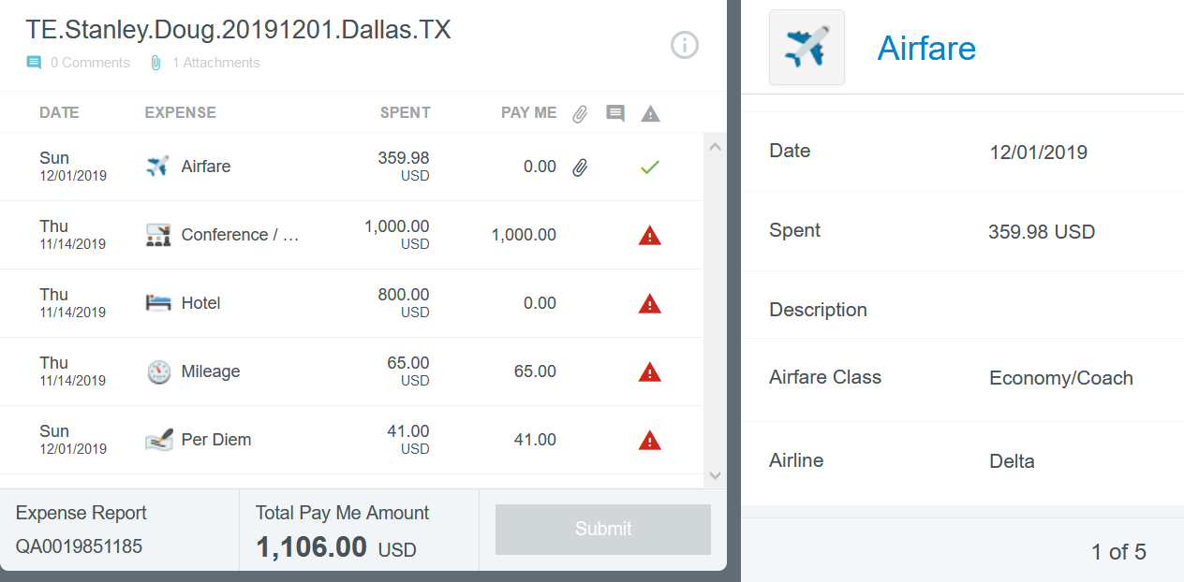
After the required information is provided, a green check is displayed beside the expense. In this example, the airfare was paid by ProCard prior to the travel date. The other expenses will be deleted from this Expense Report; however, the remaining transactions will import on the next Expense Report.
Delete each expense by clicking the expense and clicking Delete two times.

Slide 51
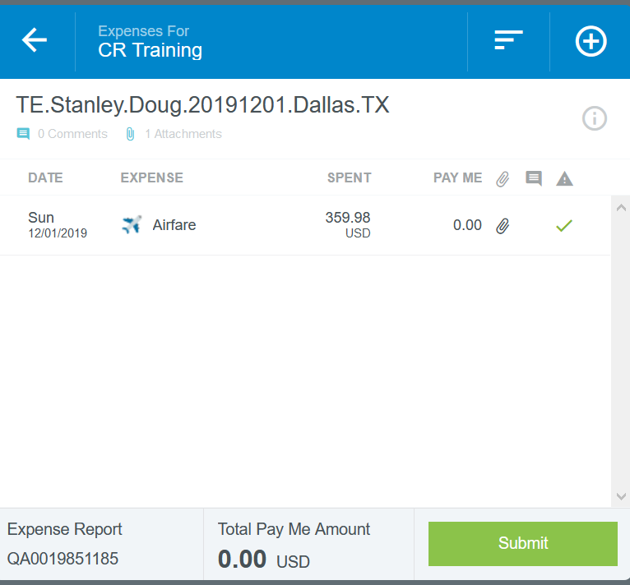
The green check is displayed and all other expenses are deleted. This Expense Report is now ready to be submitted.
NOTE: Verify the Total Pay Me Amount. In this example the airfare was paid by ProCard.

Slide 52
Add Ground Transportation Expense
APPLY PROCARD TRANSACTIONS
  Click Credit Card
  Drag and drop
  Enter Required Info
  Verify Allocation (FOAPAL) is correct
  Add Attachments (slides #16-17)
PROCESS REIMBURSEABLE EXPENSES
  Click the Ground Transportation Tile
  Select the Ground Transportation Expense Type
  Enter Amount, Description, Required Info
  Verify Allocation (FOAPAL) is correct
  Add Attachments (slides #16-17)
  Click Save
Notes:
https://app.ca1.chromeriver.com/login

Slide 53
Add Hotel Expense
APPLY PROCARD TRANSACTIONS
  Click Credit Card
  Drag and Attach
  Select Merchant
  Itemize and Save Chrome River Office Video: How to Itemize a Hotel Receipt
  Verify Allocation (FOAPAL) is correct
  Add Attachments (slides #16-17)
PROCESS REIMBURSEABLE EXPENSES
  Click the Expense Type
  Enter Amount, Description, Required Info
  Itemize and Save Chrome River Office Video: How to Itemize a Hotel Receipt
  Verify Allocation (FOAPAL) is correct
  Add Attachments (slides #16-17)
  Click Save
Notes:
https://app.ca1.chromeriver.com/login

Slide 54
Add Meals Expense
APPLY PROCARD TRANSACTIONS
  Click Credit Card
  Drag and drop
  Enter Required Info
  Verify Allocation (FOAPAL)
  Add Attachments (slides #16-17)
PROCESS REIMBURSEABLE EXPENSES
  Click the Meals Tile
  Select the expense type
  Enter Amount, Description, Required Info
  Verify Allocation (FOAPAL) is correct
  Add Attachments (slides #16-17)
  Click Save
Chrome River Office Video: Per Diem Wizard
NOTE: ProCard would only be used for a meal for a group. An itemized receipt and list of guests is required.
NOTE: Per Diem is calculated by a daily rate mandated by the state of NC. The daily amount is based on the travel departure time and return time.
Notes:
https://app.ca1.chromeriver.com/login

Slide 55
Add Miscellaneous Other Expense
APPLY PROCARD TRANSACTIONS
  Click Credit Card
  Drag and drop
  Enter Required Info
  Verify Allocation (FOAPAL) is correct
  Add Attachments (slides #16-17)
PROCESS REIMBURSEABLE EXPENSES
  Click the Miscellaneous - Other Tile
  Select the expense type
  Enter Amount, Description, Required Info
  Verify Allocation (FOAPAL) is correct
  Add Attachments (slides #16-17)
  Click Save
Notes:
https://app.ca1.chromeriver.com/login

Slide 56
Add Registration Expense
APPLY PROCARD TRANSACTIONS
  Click Credit Card
  Drag and Drop
  Enter Required Info
  Verify Allocation (FOAPAL) is correct
  Add Attachments (slides #16-17)
PROCESS REIMBURSEABLE EXPENSES
  Click the Registration Tile
  Select the expense type
  Enter Amount, Description, Required Info
  Verify Allocation (FOAPAL) is correct
  Add Attachments (slides #16-17)
  Click Save
Notes:
https://app.ca1.chromeriver.com/login

Slide 57
Move ProCard Expense from cardholder’s eWallet to traveler’s eWallet
ProCard holder makes a purchase for a travel related expense for another ECU employee. (exp. Registration fees, airfare, hotel, etc.)
The ProCard Expense will need to be moved from the ProCard holder‘s eWallet to the traveler’s eWallet
The ProCard holder will create a Team Dynamix ticket to request that the ProCard Expense be moved to the traveler’s eWallet
Go to Chrome River Team Dynamix Ticket Request link
Enter the request to move the ProCard travel expense transactions from the ProCard holder’s eWallet to traveler’s eWallet
The traveler, or delegate, will submit a Travel Expense Report with the ProCard transactions within 30 days of the purchase. The travel expenses purchased prior to the departure date can be processed prior to the departure date.
Chrome River Office Video: Moving ProCard Charges
Notes:
https://app.ca1.chromeriver.com/login

Slide 58
Label ProCard Transaction as Personal Expense
Assign the personal expense to the correct category (Lodging, meals, etc.)
Click the Appropriate Tile
Apply Personal ProCard Transactions
Select the expense type
Enter Amount, Description, Required Info
Change FUND/ORGN/PROG to 140299-230606-0000 - this transaction will not be deducted from the departmental budget. The personal ProCard transaction will be tracked as a receivable in FOAP 140299-230606-12451-0000
Add Attachments (slides #16-17)
Click Save
***Note: The Personal Expense Amount will be collected in the ProCard Office or paid by U-Store. If payment is not received in a timely manner, the ProCard will be suspended.
Notes:
https://app.ca1.chromeriver.com/login

Slide 59
Submit after all expenses are added to the Travel Expense Report
After all Travel Expenses have been added to the Expense Report, and a green check is displayed
Click Submit
Click Submit for Confirmation
The Expense Report will be listed on the Chrome River Dashboard in the Submitted Section
After the Travel Expense Report is Submitted, the automated approval routing process begins as follows:
  Expense Owner Approval (Traveler)
  HR Supervisor Approval
  Approval routing based on the business rules built into Chrome River
  Approval by the Chrome River Office Staff
  Transaction feeds to Banner nightly
Automated emails will be sent after each level of approval. Within the email will be a link for the approver to open and view the Pre-Approval Report or Expense Report. The approver can approve the Chrome River request within the email.
To Track/View the Approval Process, see slide #13.

Slide 60
Instructions to Reconcile ProCard Transactions for a Candidate or Group Purchase

Slide 62
Create Expense Report Header for
ProCard Travel Reconciliation
Verify that the correct ProCard Holder’s name is listed in the top right corner
Click the plus NEW (top right)
Click New Expense Report
Enter Report Name PCT.Cardholder Name.End Date example: PCT.Hopper.Steven.11.15.2019
Select Pro-Card Travel Reconciliation from the Report Type dropdown
Enter Departure Date
Enter Return Date
Enter Departure Time
Enter Return Time
Select Travel Type from the dropdown
Click Save
***Note: Expense Report number is created and displayed in the bottom left corner.

Slide 63
Add Expenses for
ProCard Travel Reconciliation
Click Credit Card
Check beside the desired transactions
Click Add
Note: Date and Amount will populate
Enter detailed Business Purpose
If needed, enter description and attendees
Select Account from the dropdown list
Allocation Section
  Select FUND and ORGN from the dropdown list
  Select Non-Travel from the Expense Type dropdown list
  Select Activity code if applicable; select N/A if no Activity code is needed
Add Attachments (see slides #16-17)

Slide 64
Edit/View the ProCard Travel Reconciliation Expense Report
The Expense Report will be listed on the Chrome River Dashboard in the Draft Section until the final Submit Process is complete
To View the Expense Report
  Go to the Chrome River Dashboard
  Click the Draft Number/Title
  Select the Desired Expense Report
  Click Open
To Add more Pro Card transactions to the Expense Report, Click
Repeat the steps in slide #63
Multiple ProCard transactions can be added to an Expense Report and held as a “Draft” until the expense report is submitted. Click Save and the Expense Report will be held in Draft column on the Chrome River Dashboard.
After all ProCard transactions have been selected for the expense report complete the Submit process on slide #65.

Slide 65
Submit After all ProCard transactions are added to the Expense Report
After all ProCard transactions have been selected, Click Submit
Click “Submit for Confirmation
The Expense Report will be listed on the Chrome River Dashboard in the Submitted Section
After the Expense Report is Submitted, the automated approval routing process begins as follows:
  ProCard Holder Approval
  HR Supervisor Approval
  Approval routing based on the business rules built into Chrome River
  Approval by the Chrome River Office Staff
  Transaction feeds to Banner nightly
Automated emails will be sent after each level of approval. Within the email will be a link for the approver to open and view the Pre-Approval Report or Expense Report. The approver can approve the Chrome River request within the email.
To Track/View the Approval Process, see slide #13.

Slide 66
Expire (liquidate) the Pre-Approval Report unused balance
The expire (liquidation) process is needed to release the encumbered amount.
It is likely that the Pre-Approval Report amount and the Travel Expense Report amount will not equal; therefore, the expire (liquidation) process is needed.
The unused balance on the “T” document can be removed by following the steps on slides 66-67.
If the preparer does not expire the unused balance, an automatic process will expire the unused balance 120 days after the last date of travel.

Slide 67
Expire Pre-Approval Report Unused Balance Instructions
Return to the Chrome River Dashboard by clicking
Click on the number to view the list of Pre-Approval Reports; in this example, click 12
Click the desired Pre-Approval Report
Click Expire

Slide 68
Instructions to Create Blanket Travel Pre-Approval Report
Chrome River Office Video: How to Create a Blanket Travel Order

Slide 70
Create Pre-Approval Report Header for Blanket Travel
Verify that the correct Employee Traveler’s name is listed in the top right corner
Click the plus NEW (top right)
Click New Pre-Approval Report
Enter Report Name (BL prefix to identify as Blanket Travel, traveler’s last name, first name, months covered under Blanket) example: BL.Doughtie.Penney.Oct19-Jun20)
Enter Blanket Travel Start Date and End Date (or fiscal year 7/1/2019 and 6/30/2020)
Enter a Business Purpose Description
Select Report Type from the dropdown (Travel – Blanket)
Select Travel Type from the dropdown (In-State, Out-of-State)
Select Destination from the dropdown list. Note: a Blanket Travel can have many destinations
Select No from the dropdown list Excess Lodging Authorized
  No lodging is allowed on Blanket Travel
Allocation Section
  Select FUND and ORGN from the dropdown list
  Select In-State, Out-of-State from the dropdown list
  Select Activity code if applicable
Click Save
***Note: Pre-Approval Report ID is created and displayed in the bottom left corner.

Slide 71
Add estimated expenses to the Blanket Travel Pre-Approval Report
Blanket Travel expenses include mileage, gas, parking fees, and tolls.
Click the Ground Transportation Tile
Select the expense type
Enter Estimated Amount
Add a Description
Click Save

Slide 72
Submit after all estimated expenses are added to the Blanket Travel Pre-Approval Report
Click Submit
Scroll to the bottom to Upload Attachments (see slides #16-17)
Click Submit
The Pre-Approval Report will be listed on the Chrome River Dashboard in the Submitted Section
To View the Pre-Approval Report
  Go to the Chrome River Dashboard
  Click the Submitted Number/Title
  Select the Desired Pre-Approval Report
  Click Open
  Attachments can be added (see slides #16-17)
  Changes can be made (see slide #89)

Slide 73
Blanket Travel Pre-Approval Report
Automated Approval Routing Process
After the Blanket Travel Pre-Approval Report is Submitted, the automated electronic approval process begins as follows:
  Expense Owner Approval
  HR Supervisor Approval
  Approval routing based on the business rules built into Chrome River
  Approval by the Chrome River Office Staff
  Transaction feeds to Banner nightly
Automated emails will be sent after each level of approval. Within the email will be a link for the approver to open and view the Pre-Approval Report or Expense Report. The approver can approve the Chrome River request within the email.
To Track/View the Expense Report, see slide #13.

Slide 74
Blanket Travel Guidelines
If the mileage exceeds 100 miles, the user should record the daily mileage so the higher mileage rate would apply.
A log sheet can be attached for an entire week/month. To receive the correct mileage rate; the user will enter the daily miles. After all mileage is recorded, attach a log sheet instead of using a Google Map. The user will receive a Google Map Error, respond with, “see attached log sheet.”

Slide 75
Blanket Travel
NFR – No Fund Request
A Pre-Approval Report is needed even if no reimbursement is requested. Chrome River requires an amount on the Pre-Approval Report; therefore, minimal amount of $1 can be entered. At fiscal year-end, EXPIRE the Pre-Approval Report funds to release the encumbered amount from the departmental budget.
A travel rule update from the Travel Office:
1. If an employee is traveling out of town, a Pre-Approval Report (Blanket Travel) is required even if no reimbursement is requested. For the Blanket Travel Pre-Approval Report enter $1.00 so that the budget is encumbered for a minimum amount.
2. If an employee is “potentially” traveling out of town, a Pre-Approval Report (Blanket Travel) is not needed until an employee actually travels.
3. Pre-Approval Report (Blanket Travel) is not required for employees attending meetings in Greenville, or immediate vicinity (within a 35 mile radius) of an employee’s normal duty station, unless the employee is seeking reimbursement for the local travel.

Slide 76
Instructions to Create Blanket Travel Expense Report to Reimburse Employee

Slide 78
Create Expense Report Header for Blanket Travel Reimbursement
Verify that the correct Employee Traveler’s name is listed in the top right corner
Click the plus NEW (top right)
Click New Expense Report
Click Import Pre-Approval
Select the Pre-Approval Report from the dropdown list
Click Import
Select the Travel – Blanket from the Report Type dropdown
Enter Travel Date in the Departure Date Cell and Return Date Cell
Enter Travel Time in the Departure Time Cell and Return Time Cell
Select Travel Type from the dropdown (In-State, Out-of-State)
Select Destination from the dropdown list
Click Save
***Note: Expense Report ID is created and displayed in the bottom left corner.

Slide 79
Add Expenses
Blanket Travel expenses include mileage, gas, parking fees, and tolls.
Select the expense type
Enter Amount
Add a Description
Verify that Allocation (FOAPAL) is correct
Add Attachments (slides #16-17)
Click Save
***Note: Mileage is calculated on the official NC state rate. If the exempted rate is approved, (mostly for 314/315 Funds), see slide #48 for calculation instructions.
Notes:
https://app.ca1.chromeriver.com/login

Slide 80
Submit after all expenses are added to the Blanket Travel Expense Report
After all expenses have been added to the Blanket Travel Expense Report, Click Submit
Click Submit for Confirmation
The Pre-Approval amount will be decreased by the amount of the Expense Report
After the Blanket Travel Expense Report is Submitted, the automated approval process begins as follows:
  Expense Owner Approval (Traveler)
  HR Supervisor Approval
  Approval routing based on the business rules built into Chrome River
  Approval by the Chrome River Office Staff
  Transaction feeds to Banner nightly
Automated emails will be sent after each level of approval. Within the email will be a link for the approver to open and view the Pre-Approval Report or Expense Report. The approver can approve the Chrome River request within the email.
To Track/View the Expense Report, see slide #13

Slide 81
Chrome River Approval Process

Slide 82
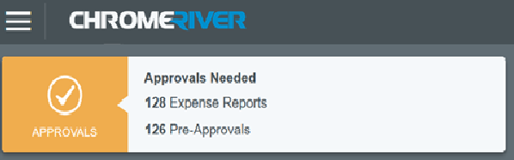
What is a Chrome River Approver?
A Chrome River Approver has been given the authority to approve/reject reports within Chrome River, including Travel Pre-Approvals, Travel Reimbursements, Blanket Travel Reimbursements, ProCard transactions, etc.

Slide 83
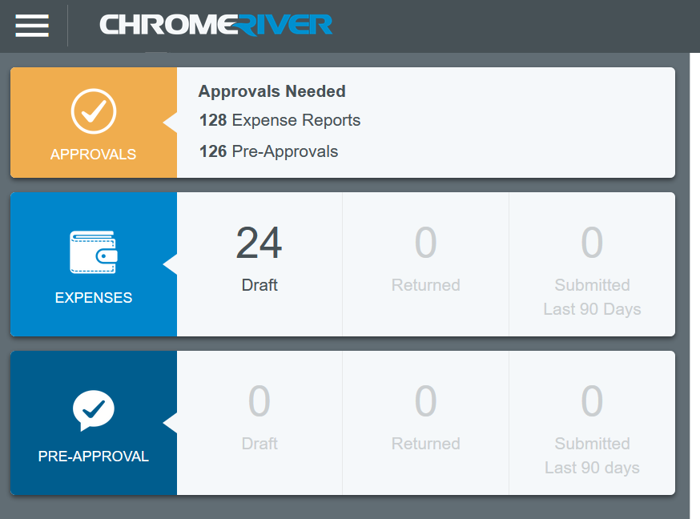
Approval Process
Chrome_River_Office Video: How to Approve Reports in Chrome River
Approver will have a GOLD section, labeled “APPROVALS”
Click the number to view the list. In this example, click 128.
Select the desired Pre-Approval Report or Expense Report.
Review the FOAP, amount, business purpose, receipt, etc.
If all information is correct and transaction is approved, then click Approve.
If information is incorrect, click Return.
The Approver will also receive an automated email and can access the Pre-Approval/Expense Report and Approve within the email.

Slide 84
Automated Approver Notifications
Chrome River Approvers will receive automated emails.
Approvers can review all information, view receipts, and Approve/Reject the Pre-Approval Report or Expense Report.
The Approver can approve the Pre-Approval Report or Expense Report by using the provided link within the email message.
The Approver (or Approval Delegate) does not have to log into Chrome River to Approve/Reject.

Slide 85
Approver Responsibilities
The ProCard and travel policies at ECU have not changed and should be processed within thirty days; therefore, the Approver or Approval Delegate will review Pre-Approval Reports and Expense Reports as follows:
  Dates
  Expense Type
  Person receiving reimbursement or travel Pre-Approval
  Funding Source (FOAPAL) Note: Chrome River has no ORGN security; therefore, close review of the FOAPAL is crucial
  Legible copies of receipts
  Receipt dates
  Business Purpose
  Etc.
  ***Note: An approver can change the FOAP on an Expense Report.

Slide 86
Approval Delegate
Can an approver assign a delegate while they are away from the office (example: vacation, business travel, jury duty)?
  Yes, in Chrome River, an Approver can assign one Approval Delegate for a certain time
  period. All actions, including automated Chrome River emails, that would normally route to the Approver will now route to the Approval Delegate. See slides #85-86.

Slide 87
Instructions to assign an Approval Delegate
Approval Delegate – designated by the approver to temporarily assume approval authority in Chrome River. Only one approval delegate is allowed.
Instructions to Assign an Approval Delegate
Click your name which is displayed in the top right corner of the Chrome River Dashboard
Click Settings from the dropdown
Click Delegate Settings in the left menu
Click Add Approval Delegate ***Note: Only one approval delegate is allowed.
Enter the Approval Delegate’s First and Last Name
Enter Start Date and End Date
Click Save
The Approval Delegate’s name will be listed under My Approval Delegate
***Note: To Remove an Approval Delegate, simply click the “X” beside their name.

Slide 88
Chrome River Miscellaneous Processes
Slide 89 Encumbrance Process
Slide 90 Correction Process
Slide 91 Personal ProCard Transactions
Slide 92 Assign Delegates to submit reports on one’s behalf
Slide 93 View Pre-Approval and Expense Reports older than 90 days
Slide 94 Team Dynamix Service Tickets Process
Slide 95 Chrome River Training Resources
Slide 96 Chrome River Contact Information
Slide 97-100 Chrome River Glossary
Slide 101 Document Descriptions

Slide 89
Encumbrance Process for Pre-Approval Reports (Travel and Blanket Travel)
When a Pre-Approval Report is created and approved in Chrome River, the transactions will feed to Banner as a “TO document”. The pre-approval amounts will be listed in the Encumbrance column and deducted from the budget.
After the Pro-Card transactions are applied to the Pre-Approval Report by a “PC document”, the encumbrance amount is reduced by a “TA document” and moved to the Year-to-Date column in the budget.
After Travel Expense Reports are created and approved requesting a traveler to be reimbursed by a “TC document”, the encumbrance amount is reduced by a “TA document” and moved to the Year-to-Date column in the budget.
After the PreApproval Report amount has been used in full, the encumbrance will be automatically expired/closed by a “TL document”.
After the final Expense Report has been submitted and there is an unused balance on the Pre-Approval Report, the unused encumbrance balance can be manually (liquidated) expired/closed (See slides #66-67) by “TL document”.
If a Pre-Approval Report has not been fully expired after 120 days, the automated process will expire the unused balance by a “TL document”.
Blanket Travel will not expire until the end of the fiscal year (June 30th).

Slide 90
Correction Process for Pre-Approval Report or Expense Report
A preparer can Recall a Pre-Approval Report or Expense Report if it is in the “Pending” status; however, if the report is Approved, no changes are allowed.
Once the Pre-Approval Report or Expense Report has been Recalled, it will be listed in the “Returned” column. The preparer can make FOAPAL changes and documentation updates are allowed.
If any level of approval finds a wrong FOAPAL or missing documentation, the approver will deny the Pre-Approval/Expense Report. It will return to the preparer’s “Returned” column and the preparer will make needed changes and resubmit.
A preparer can remove an attachment once the Pre-Approval Report or Expense Report has been Recalled. Select the attachment and click the delete icon in the top left corner.

Slide 91
Process Personal ProCard Transactions
Personal purchases should never be charged to the ECU ProCard; however, if it happens follow these steps:
  Use FOAPAL 140299-230606-0000 to identify the personal expense. This transaction will not reflect in the departmental budget. The personal ProCard transaction will be tracked as a receivable in FOAP 140299-230606-12451-0000.
The Personal Expense Amounts will be collected in the ProCard Office or paid by U-Store. If payment is not received in a timely manner, the ProCard will be suspended.

Slide 92
Assign Delegates to submit Pre-Approval Reports or Expense Reports on one’s behalf.
Delegate – a user that is assigned by the expense owner or traveler to create and submit reports on their behalf. Once setup, a delegate remains in that role until removed by the expense owner/traveler. As a delegate, they can view, edit, and create on behalf of the expense owner/traveler. All reports created by the delegate will go to the expense owner/traveler for approval.
Instructions to Assign a Delegate
Click your name which is displayed in the top right corner of the Chrome River Dashboard
Click Settings from the dropdown
Click Delegate Settings in the left menu
Click Add New Delegates
Enter the Delegate’s First and Last Name and their name will be listed under My Delegates
***Note: To Remove a Delegate, simply click the “X” beside their name.

Slide 93

View Pre-Approval Reports and Expense Reports older than 90 Days
Pre-Approval Reports and Expense Reports can be tracked on the Chrome River Home Page, see slide #13. After 90 days, the Pre-Approval Reports and Expense Reports are moved over to the Chrome River Reports under Inquiry.
Instructions to View Pre-Approval Reports and Expense Reports Older than 90 days
Click the menu icon in the top left corner of the Chrome River Dashboard
Click Inquiry
Click Expense
Click the desired Chrome River Report
  Create the report date
  Click Apply
  Click the desired Report Name
  Click Download PDF
  Click Export and Click OK if Excel spreadsheet is needed

Slide 94
Chrome River Team Dynamix Service Ticket Requests
Chrome River Team Dynamix Ticket Request link
Submit a Team Dynamix Ticket Request for the following:
To request adding/maintenance to a FUND, ORGN, ACCT, or ACTV in Chrome River
To move ProCard Transactions if a traveler is different from the cardholder (from delegate’s eWallet to traveler’s eWallet)
To move the Pre-Approval from one user to another if the person changes departments or is absent for extended period
To add Non-Employee Students, Fellows, Residents, or Dental Students to reimburse for Travel Expenses
Routing Questions
Policy Questions
General Chrome River Support

Slide 95
Chrome River
Training Resources
Chrome River Office videos https://mediasite.ecu.edu/MS/Catalog/catalogs/chrome-river
Face to Face training, register on Cornerstone
WEBEX Schedule (Online Training with Chrome River Office)
Chrome River has a Help feature located on the Chrome River Dashboard
  Click the user’s name in the right corner
  Click Help
  Search by topics

Slide 96
Chrome River
Contact Information
ECU Chrome River Office email ecu_chrome_river@ecu.edu
ECU Chrome River Hot Line 252-737-5700
ECU Chrome River website
https://financialservices.ecu.edu/travel-office/
ECU ProCard email procard@ecu.edu
ECU ProCard Phone 252-737-5545
ECU ProCard website https://financialservices.ecu.edu/procard/

Slide 97
Glossary
Activity Code – is the fifth element in the FOAPAL. It is used to track special events, Grants F&A, Faculty/Physicians activity, etc.
Allocation – Chrome River term for the FOAPAL, (FUND, ORGN, ACCOUNT, PROGRAM,
ACTIVITY and LOCATION). Chrome River has the FUND and ORGN linked together.
Approval Delegate – designated by the approver to temporarily assume approval authority in Chrome River. Only one approval delegate is allowed.
Approver – has been given the authority to review/approve/reject reports within Chrome River, including Travel Pre-Approvals, Travel Reimbursements, Blanket Travel Reimbursements, ProCard transactions, etc. Approver rules are automatically assigned in the Chrome River Approval process which includes the following: expense owner, traveler’s HR supervisor, ORGN approver, FUND approver, Chrome River Office, etc.
Business Purpose – a brief generalized reason for the travel or expense.
Cash Advance – is requested during the Pre-Approval Process to gain funding prior to travel departure date.

Slide 98
Glossary
CR SNAP Application – is used to scan receipts on cellphones and automatically uploads the receipt into the Chrome River Receipt Gallery.
Dashboard – the Chrome River Home Page.
Delegate – a user that is assigned by the expense owner or traveler to create and submit reports on their behalf.
Description – a cell used to provide expense details.
Encumbrance – Pre-Approvals will encumber funds and deduct the dollar amount from budgets. The Pre-Approval amount will be listed in the Encumbrance column in Banner Finance. eReceipts/Receipt Gallery – scanned receipts and CR Snap receipts are stored in the receipt gallery until the expense report is complete. eWallet – credit card transactions are stored in the eWallet until the ProCard transactions are applied to an Expense Report.

Slide 99
Glossary
Expense Owner – the person who incurs the expense: ProCard holder, Traveler, Person that used their personal money.
Expense Report – Chrome River Report type used to initiate payments: Travel Reimbursement, ProCard reconciliation process, and Reimbursement to an Employee for Non-Travel.
Local Travel – daily travel, within the state boundaries for mileage, parking fees and tolls.
Naming Convention – the title that the preparer creates for the Pre-Approval or Expense Report. (see slide #12)
Non-Business Travel – non-refundable travel expenses for additional days added to approved business travel trip and used for personal purposes.
Non-Reimbursable Personal Expense – personal expenses incurred during travel that are non-refundable like entertainment, expenses that are not allowed by the FUND guidelines, personal stops, etc.

Slide 100
Glossary
Pre-Approval Report – Chrome River report type used for Travel Approval to encumber funds. The encumbered expense amount is deducted from the budget in the Encumbrance column in Banner Finance.
Prepaid Expense – a travel-related expense paid via ProCard by someone other than the traveler. A prepaid expense will be reported by the expense owner and the traveler/delegate.
Receipt Gallery/eReceipts – scanned receipts and CR Snap receipts are held in the receipt gallery until the expense report is complete.
Report Header – the first page of a Pre-Approval Report or Expense Report.
Report Name – the naming convention for Pre-Approval Reports and Expense Reports that the preparer creates. (see slide #12)
Report Type – Pre-Approval or Expense Report. Pre-Approval Reports are used to approve travel prior to the travel date. Expense Reports are used for ProCard Reconciliation, Travel Reimbursements and Employee Non-Travel Reimbursement.

Slide 101
Banner Document Descriptions
TO Documents – Travel Create Original Encumbrance - Rule Class Code E10 create the original encumbrance. The encumbrance number will be a “T” and the last seven digits of the Chrome River Pre-Approval Report number.
PC Documents – ProCard Journal Entry - Rule Class Code J60 are assigned by Banner for ProCard transactions.
TC Documents – Chrome River Invoice - Rule Class Code INNI
Chrome River reimbursement transactions.
TA Documents – Travel Encumbrance Adjustment - Rule Class Code E020 are assigned by Banner for reimbursement transactions.
TL Documents – Chrome River Liquidation - Rule Class Code E032 liquidate the remaining balance of the original encumbrances and closes the encumbrance.

