Slide 1
Fixed Assets
East Carolina University

Slide 2
ECU Fixed Assets
Fixed Assets is tasked with tracking University equipment from the time it is purchased until it is disposed of in accordance with State rules and regulations
This includes:
Recording/updating identified assets in Banner.
Physically tagging equipment
Reporting results to Auditor’s and Controller’s office
Performing annual inventory spot checks

Slide 3
UNC-Business Process Standards
UNC-Business Process Standards require all universities within the UNC System to follow system-wide Capital Assets Standards. These include a requirement for the Fixed Assets Office to tag equipment within an average of 60 days.
The Fixed Assets Office must report quarterly the percentage of equipment tagged within this timeframe. These results are submitted to UNC – General Administration. Departments that have a large amount of untagged items could cause the university to be noncompliant with the UNC-Business Process Standards.
Noncompliance will trigger increased monitoring by UNC-GA and will be communicated to the Vice Chancellor level. Our office will have to provide a detailed explanation and a plan to improve our tagging process.
Appointments to tag equipment are important to maintain control over the assets of the university. Please adhere to your tagging appointments and make every effort to have your equipment tagged quickly.
If an item can not be tagged because of a delay, a statement must be submitted to FA office explaining the delay. This will be considered NIS, and will not be considered in quarterly or EOY tallies.

Slide 4
Equipment Capitalized and Tracked by Fixed Assets
Equipment with a purchase (or donation/gift) cost of $5,000 or more and useful life of 2 or more years is capitalized...all University funds
EDP equipment (computers/laptops) with a purchase cost of $2,500 to $4999 is tagged but not capped.
All Grants $3000-$4999 are tagged but not capped.
Note: Departments are responsible for tracking all assets, equipment, and supplies below these thresholds via an internal process

Slide 5
Banner Account Coding Guidelines
Based on unit cost ~
Is the unit cost less than $500? If so, code the item to a supply code (this includes software)
Is the unit cost $500 but less than $5,000 and a useful life of two or more years? If so, code the item to the appropriate non-capital equipment code
Is the unit cost $5,000 or greater? If so, the equipment is coded to the appropriate Capital equipment code. These purchases are capitalized and tagged by ECU Fixed Assets
Note: All ECU computers $2,500 or greater are tagged
by Fixed Assets

Slide 6
What is Tagged
Banner Account Codes – used on purchase orders, and any equipment expenditure
When invoices are submitted to A/P against a Capital equipment account code, Banner creates an O-tag that is extracted to the Fixed Assets’ System
Fixed Assets reviews PO, invoice, etc. and identifies FA’s.
Once the invoice(s) is paid a tag number is assigned.
Tagging appointment is scheduled and location of equipment is verified at that time.

Slide 7
Equipment Change in Status Form

Slide 8
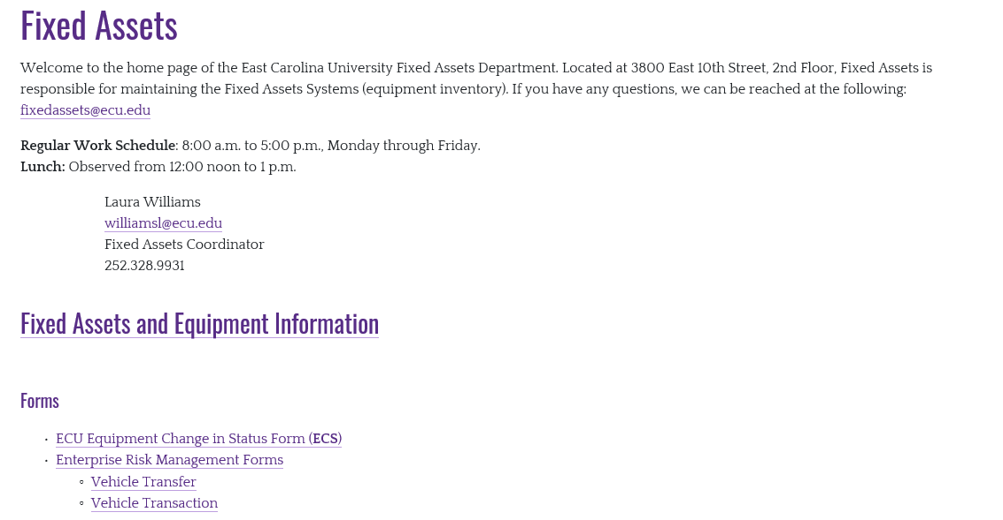
https://financialservices.ecu.edu/fixed-assets/

Slide 9
Relocation of Equipment
Fill out the top of the ECS with the FA information.
Check box for Relocated and put new location in comments.
Fill out left side on the bottom of the form
Click on the arrow in the upper right corner.

Slide 10
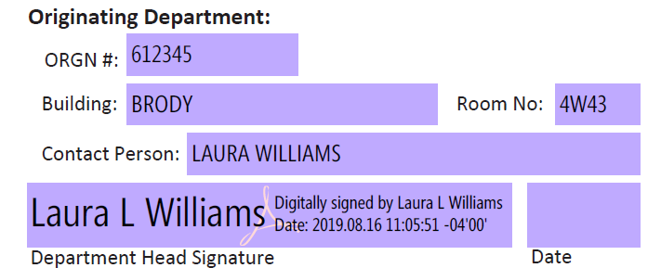

Slide 11
Transfers to Another Organization
The ECS form is filled out when one department is transferring a fixed asset to another department.
It must be a complete form with all information and signatures to be valid.
Keep a copy for your records and submit to FA.
If form is not completed by all departments, the inventory stays on the originators FYYF139.

Slide 13
Trade-In of Equipment
Used equipment can be offered as a trade-in allowance when soliciting bids or on small purchases.
Trade-in must be pre-approved by State Surplus Property
ESC form, with the justification in the other remarks box and the quote is submitted to Fixed Assets to initiate the approval process. When/if approved by NCSSPA you will receive the approval or denial email from FA. Please attach to the requisition when submitted to Materials Management.
Materials Management needs to know up front that the department has equipment they wish to trade in.
The correct account code needs to be used, taking into account the total cost of the item, including the trade-value.
The equipment cannot be released or transferred to the vendor until approved by State Surplus and properly documented by Fixed Assets.

Slide 14
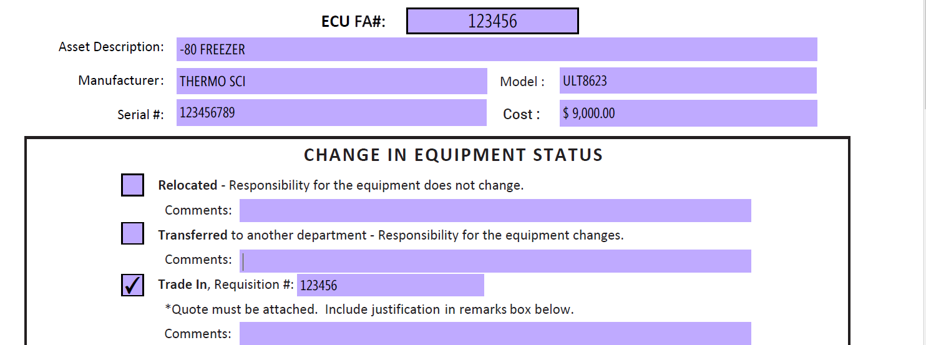
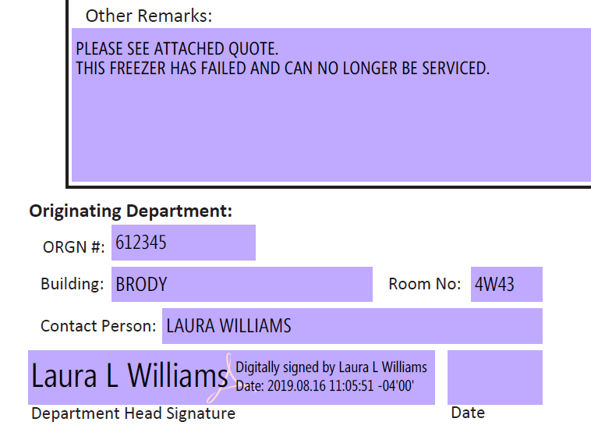

Slide 15
Equipment Taken Off-Site
Permission for removal of University-owned property may be granted only for University business and not for personal use
If property is to be off campus for a week or more, this form must be sent to the Fixed Assets Office for tracking

Slide 16
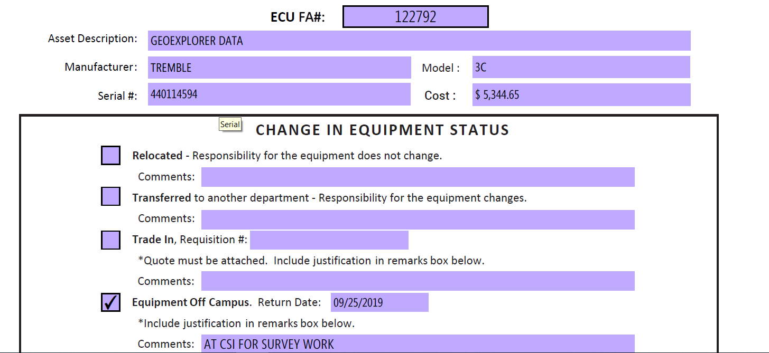
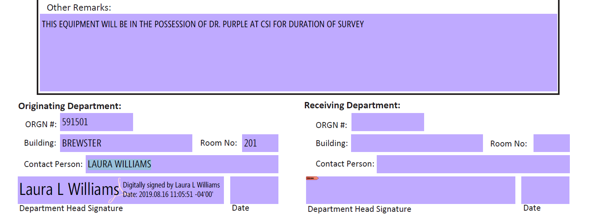

Slide 17
Home Use of Electronic Data Processing
This form will be used for EDP checked out on an annual basis.
This form must be updated during the annual inventory.
The equipment must be returned to campus for the actual inventory.
These forms are required for all EDP, tagged or not.
A note will be added to Banner and will show up on the FYYF139 inventory.

Slide 18
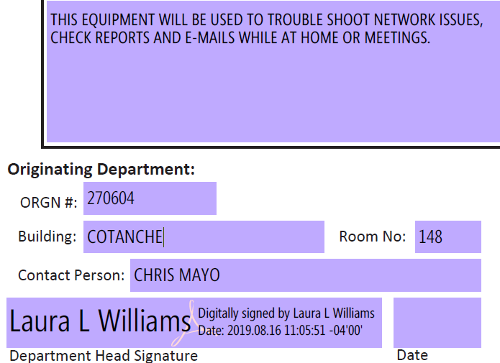

Slide 19
Stolen Equipment
Contact the proper authorities for any stolen equipment or goods (regardless of cost)
Police
ECU Police (on campus)
Local Police (off campus)
Vidant Security (BSOM)
Campus Attorney
SBI report–forwarded to Int Audit
Fixed Assets’ Office
Any Fixed Assets will be recorded as stolen and removed from departmental inventory records
If equipment is EDP, please contact ITCS.

Slide 20
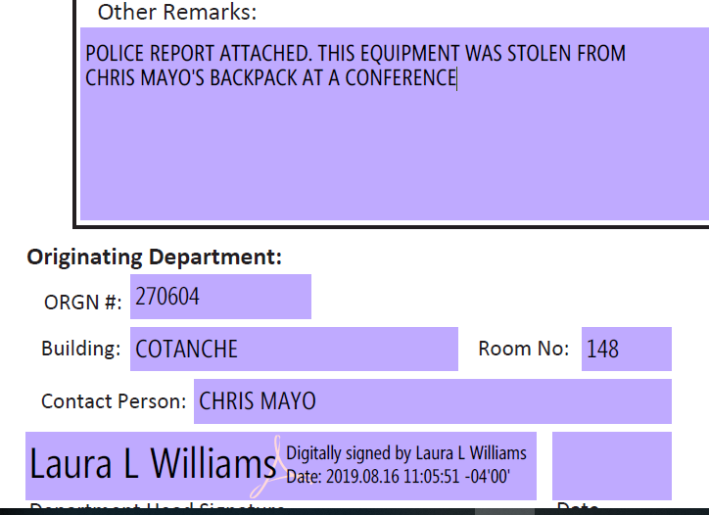

Slide 21
Cannibalized Equipment
If equipment becomes unserviceable due to obsolescence or excessive repair costs but which still has serviceable component parts that can be used to repair, modify or maintain other similar pieces of equipment, the irreparable item can be cannibalized.
Computers cannot be cannibalized.

Slide 22
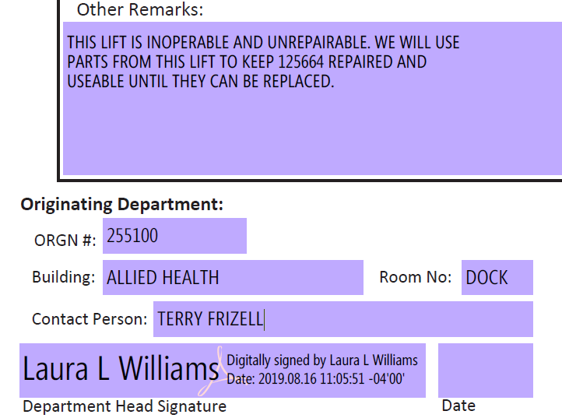

Slide 24
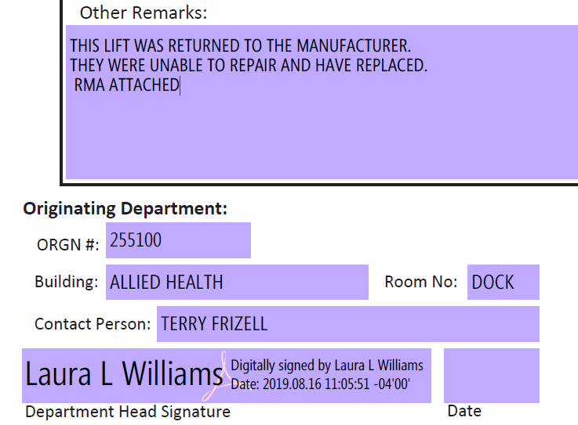

Slide 26
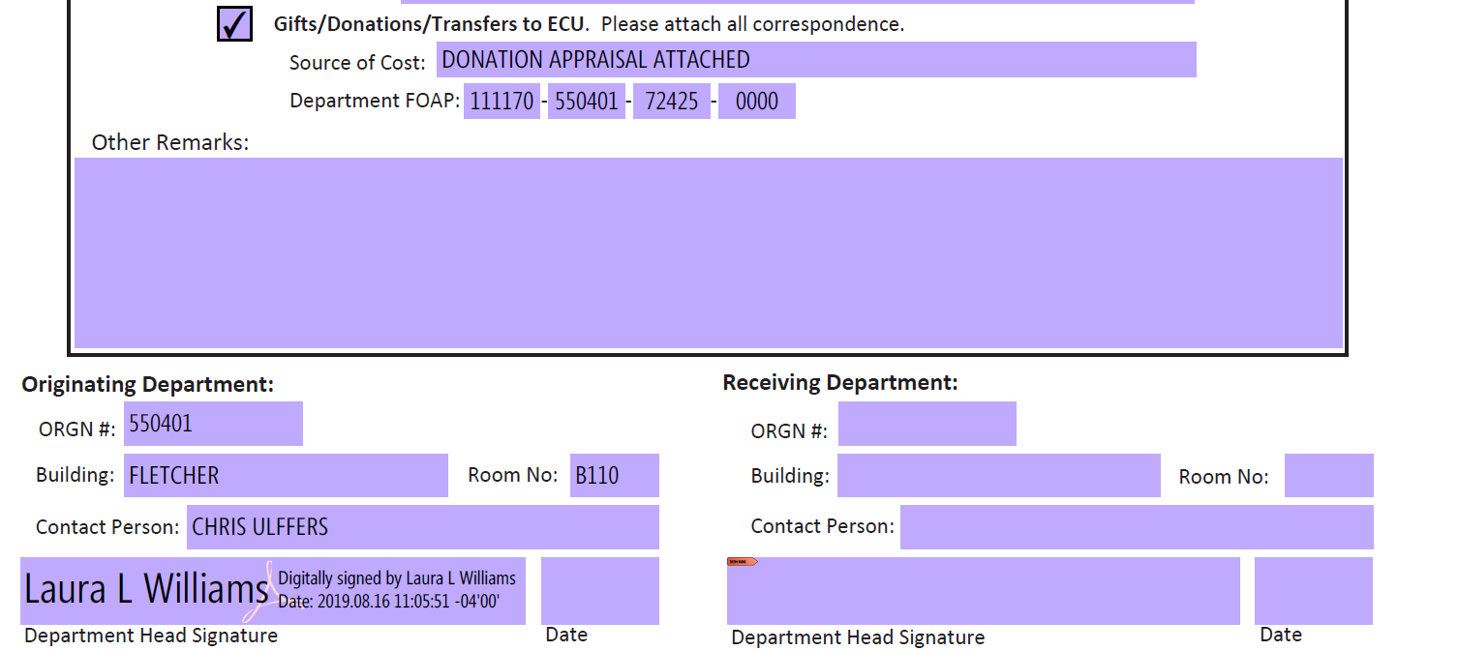

Slide 27
Tracking Inventory

Slide 28
Departmental Tracking Responsibilities
Departments are accountable for all equipment and goods under their control that do not meet the $5,000 tagging threshold (or $2,500 for EDP equipment, $3000 for Grants)
Departmental inventory reports are to be maintained and updated annually
Internal inventory is subject to audit
Internal reports are not submitted to Fixed Assets

Slide 29
Annual Verification of Inventory
ECU is required by the State to take an annual inventory
Each department is responsible for verifying their inventory and reporting any changes to Fixed Assets.
E~print reports are available Oct 1st.
To access E~print, permission must be granted via the Banner Security Request Form on PiratePort.
Make sure you are capturing all your organizations, not just the main one.

Slide 30
These are the two reports that you will need, FYYF139 and FYRF135. Not every organization has a FYRF135 Missing Inventory. Click on the PDF icon.

Slide 31
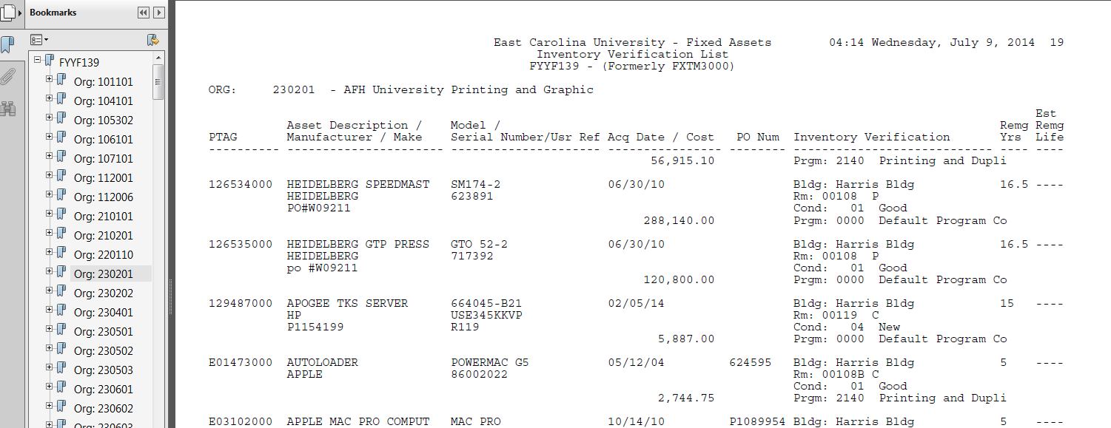
This is what the FYYF139 will look like when brought up. This should only have your organization(s) listed.

Slide 32
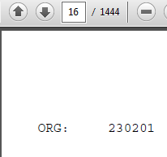
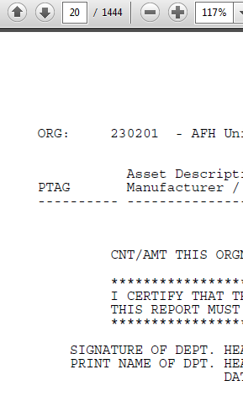
Click down until you see the last page of your organization.
Always make sure you capture the signature page.

Slide 33
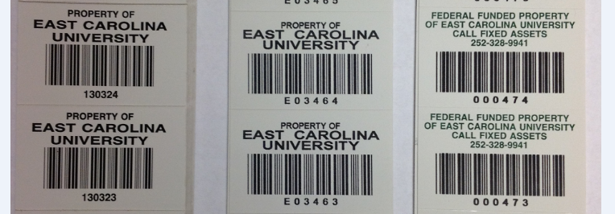
The department should physically locate each piece of equipment on the list.
Updates or additions such as condition, location, adding the serial or model number and est. useful life should be made on the inventory sheet(s).
Est. Useful life can never be less than 2 years. (Think of 2 as 0 (zero)
If a fixed asset is on your inventory that should have been removed due to any of the circumstances that we have covered, provide a copy of the paperwork.

Slide 34
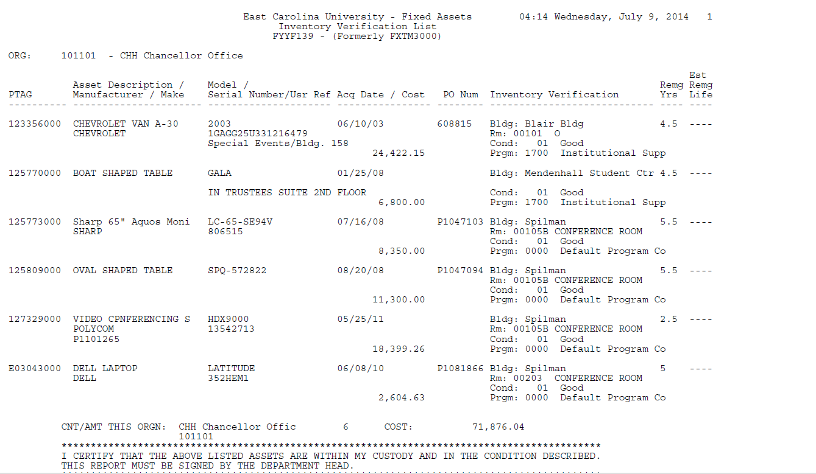
Never less than 2 years.
ASSET NUMBER
Condition
Building
Room

Slide 35
Missing Inventory List FYRF135
Equipment will remain on Missing Inventory for 1 inventory cycle, at which time it will be declared Lost and disposed of.
A reasonable explanation must be submitted to justify why a piece of equipment is considered Missing.
If an item is found, please note it on the paperwork and it will be spot checked to verify the status and updated in Banner.
This report is submitted to Internal Audit
Vice Chancellors are notified of any Missing equipment

Slide 36
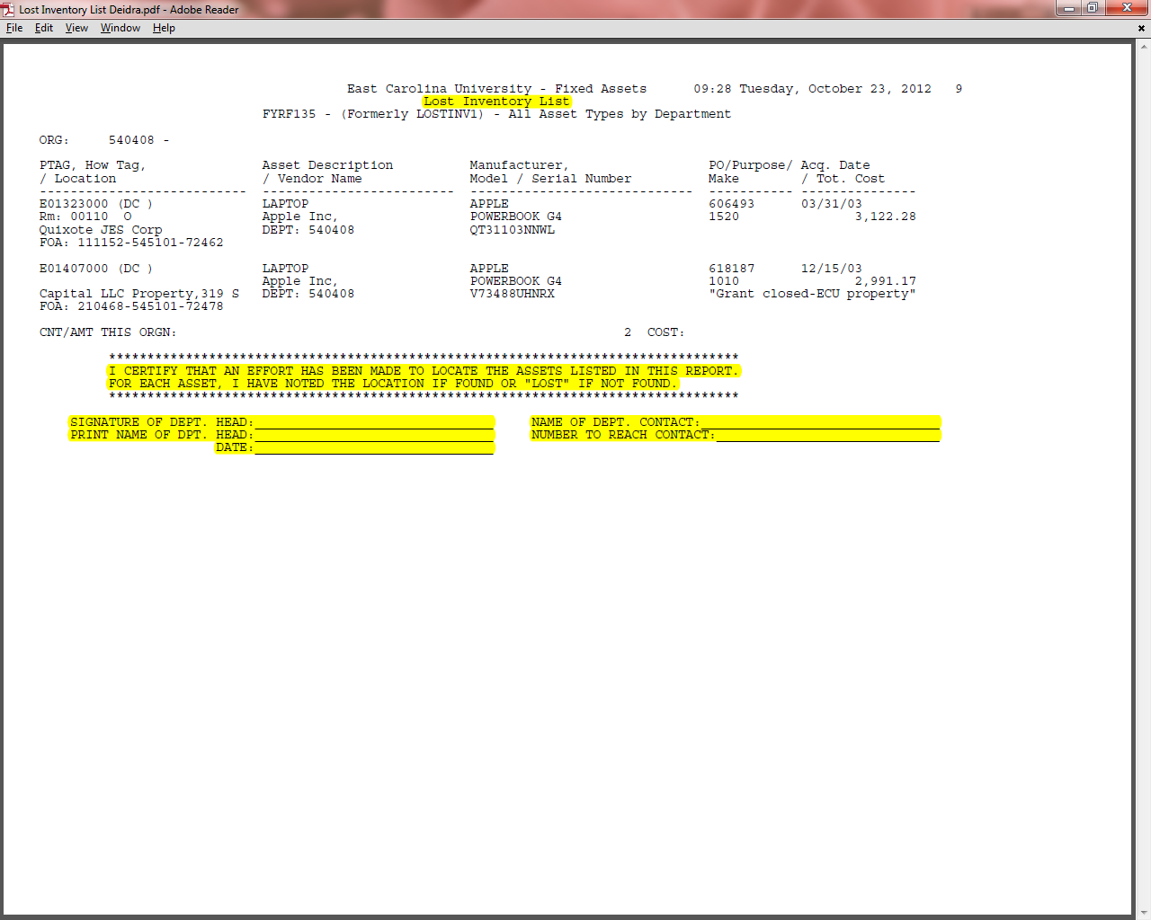

Slide 37
Audit of Inventory
Administrative Heads of each unit are responsible for the custody and proper care of equipment within his/her unit
Each unit’s inventory is subject to audit by
NC Dept. of State Auditors
ECU Internal Auditors
Fixed Assets Office Spot Inspections

Slide 38
Note
All material, equipment, or supplies purchased with any University fund is the property of the State and must be accounted for and disposed of in accordance with NCSSPA guidelines.
Departments are accountable for all inventory
Fixed Assets tracks, records, and reports capitalized inventory

Slide 39
PETS: Property Equipment Tracking System
Accessed through PiratePort

Slide 40
PETS
Property Equipment Tracking System is in place to provide a method of turning in items to Surplus.
When entering an item that is a FIXED ASSET make sure to include the ECU tag number and a serial number.
When a FIXED ASSET is received at Surplus, it is transferred in Banner to Surplus, thus relieving the organization of the asset.
If you have printed your inventory and the FA is still listed, provide the Disposal Request paperwork when you turn in your inventory.

Slide 41
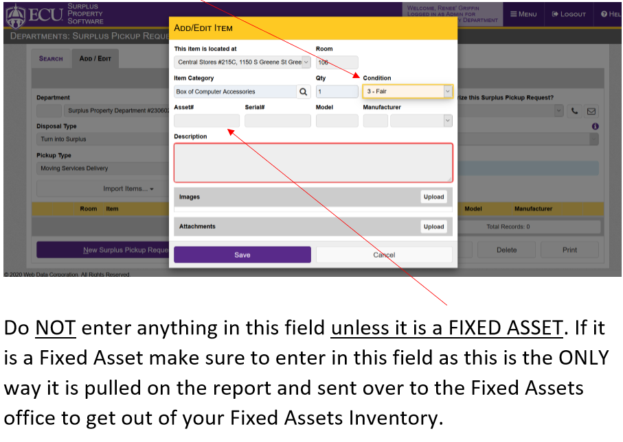
These are the instructions from the PETS Manual on the Materials Management website. https://purchasing.ecu.edu/surplus-property/

Slide 42
Questions?
Please contact me
Lynn Couturier at CouturierL@ecu.edu
Or
fixedassets@ecu.edu
Thank you for attending
I welcome your feedback and input

