Slide 1

Managing Your F&A Funds
With New ecuBIC Reports

Slide 2
What is F&A?
The Facilities and Administrative Rate (F&A Rate) is the mechanism used to reimburse the University for the infrastructure support costs associated with sponsored research and other sponsored projects. The F&A rate is essentially an overhead rate. It is calculated as a percentage of overhead associated with, an allocable to, sponsored research and other activities, divided by the direct costs of sponsored research and other activities.

Slide 3
F&A Funds
Begin with 12xxxx
Indirect cost earned from grants
50412 - Grant and Contract F&A Distribution
58259 – Indirect Cost Transfer (overhead to overhead)
Expenditures must be research related
Established at college or division level

Slide 4
General F&A Split
REDE College Dept. PI
*Agreements may vary
70%
10%
10%
10%
12xxxx Fund

Slide 5
Automated F&A Tracking Reports
The Office of Research Administration and the Institutional Trust Funds office are excited to roll out the use of activity codes in banner on F&A (overhead) funds to allow for the tracking of revenues and expenditures by PI’s and departments.
Automate and Standardize F&A accounting.
Reports of F&A revenue, expenditures, and balances per department and PI.

Slide 6
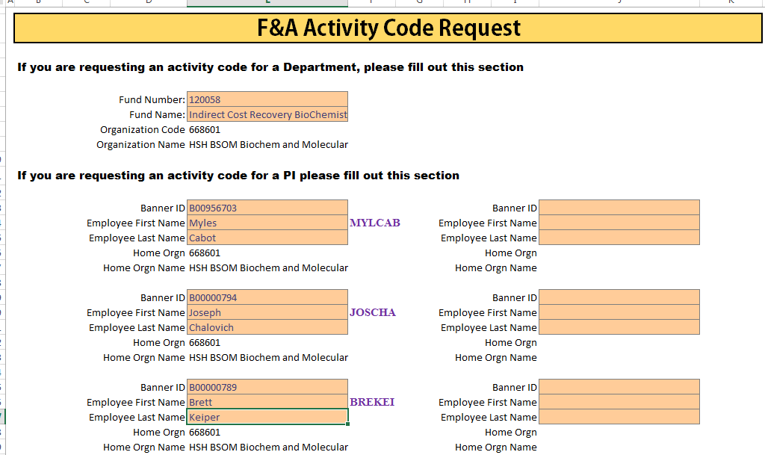
All PI’s will need to have an activity code set-up by ITF with F&A Attributes.
To request a new activity code. This form will be available on our website.
The activity code will be the first 3 of First Name and First 3 of Last Name. If duplicate activity code exists, First 3 of First Name, First 2 of Last Name and a number (ANTBE1).
The department activity code is the same as your ORGN.
Please use the PIs name as it is in Banner. For example, if you name is Thomas Smith, but they go by Tom. The activity should be THOSMI not TOMSMI
If your fund has no active PIs, a departmental activity code is still needed. You will just complete the top portion of this form.
Return all forms to ITF-SpecialFunds@ecu.edu

Slide 7
Additional Note on PI Activity Codes
Some PIs will have a two letter First name or Last, there activity will only be 5 characters instead of 6
  Al Rocker → ALROC
  Jet Li → JETLI
  Some Pis will have a hyphenated name, a name with an apostrophe, or a space in their name.
  Sandra Day O'Connor → SANO’C
  Ban Ki-Moon → BANKI-

Slide 8
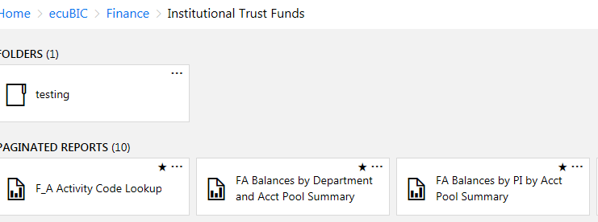

To access the reports navigate to ecuBIC.ecu.edu. Click on finance and Institutional Trust Funds. There are three reports that
relate to F&A. Please add these to you ecuBIC favorites for easy access.
Click this button to add the report to your Favorites in ecuBIC.
You favorited ecuBIC reports are located here

Slide 9
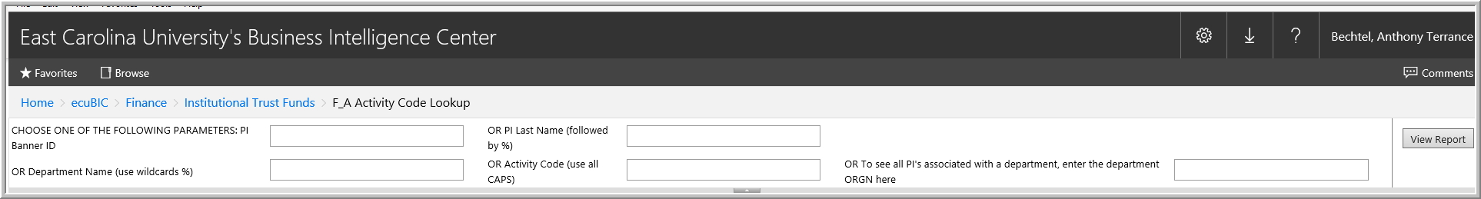
F_A Activity Code Lookup
This report is used to search for a PI activity code. You can search by Banner ID, Last Name, Department Name, Activity Code, or ORGN.
  Please read the insturctons to have a successful search. Last name needs to be followed by a %. Typing in “Smith%” will return all of the PIs with the last name Smith.
  Department Name also needs to have wild cards. For Chemistry, use “%Chemistry%”, for Academic Affairs use, “%AA%” Department will return the associated department activity code.
  Note: When using the ORGN search, a PI may have an activity code, but may not show up under you ORGN; regardless of their home ORGN this is okay as long as they have an activity code.

Slide 10
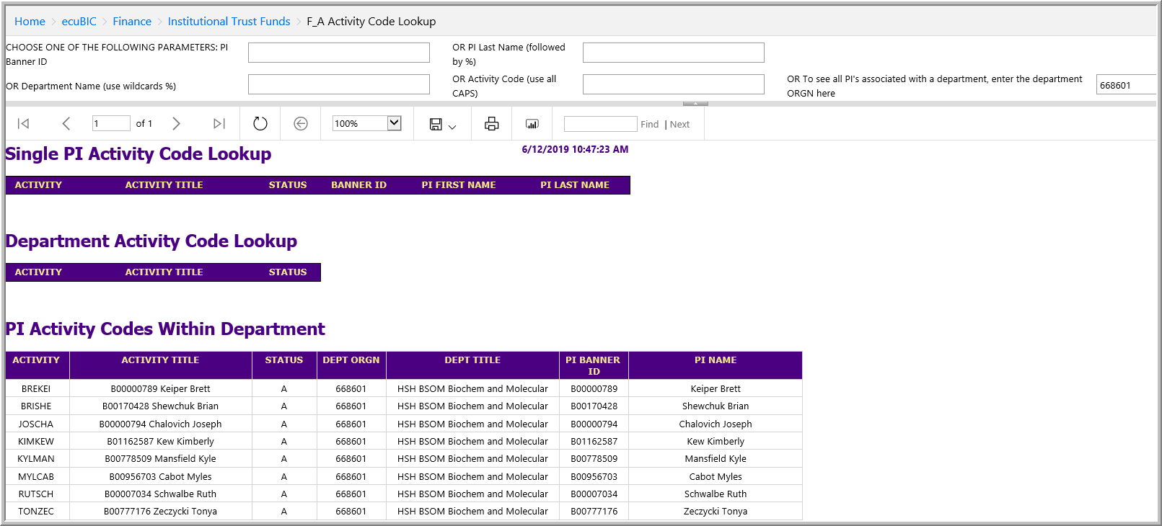
This report can be used to lookup a PIs activity code or to see all PIs associated with your ORGN.

Slide 11
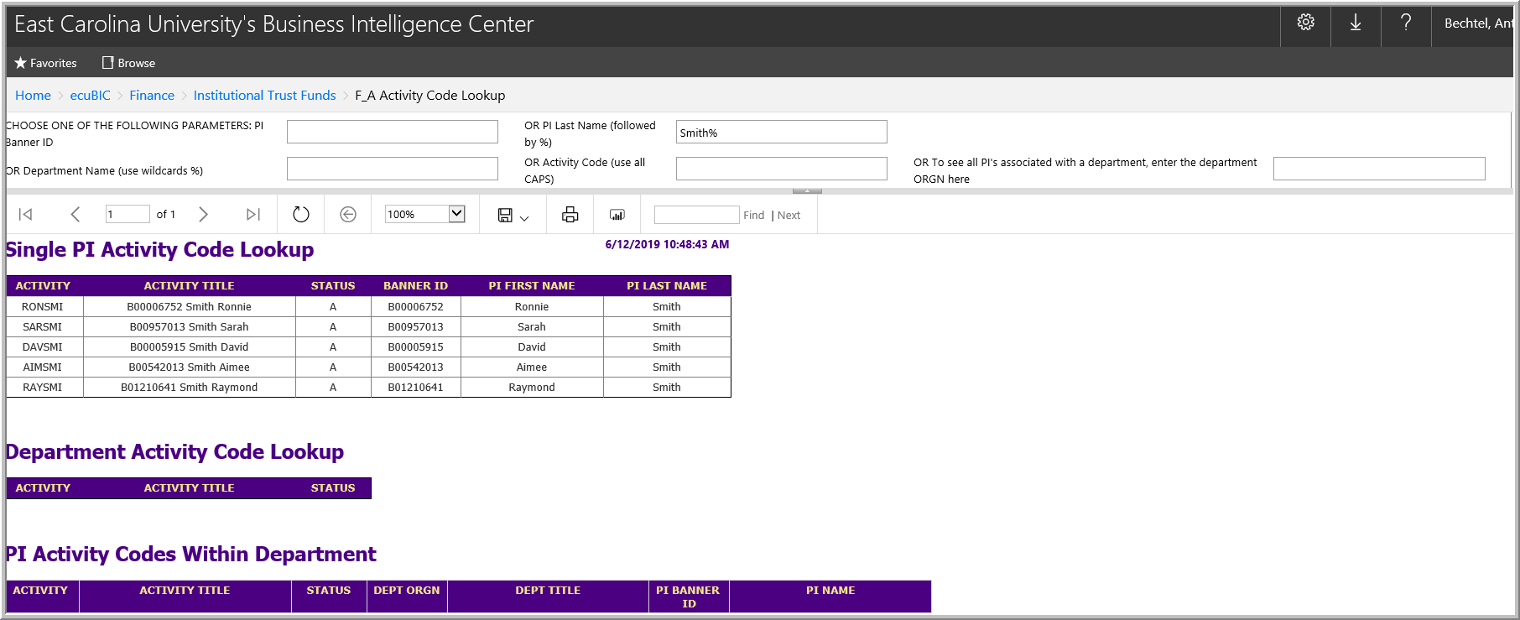
This report can also be used to lookup a PIs activity code by last name (below) or Banner ID.

Slide 12

The next report is
FA Balances by Department and Acct Pool Summary

Slide 13
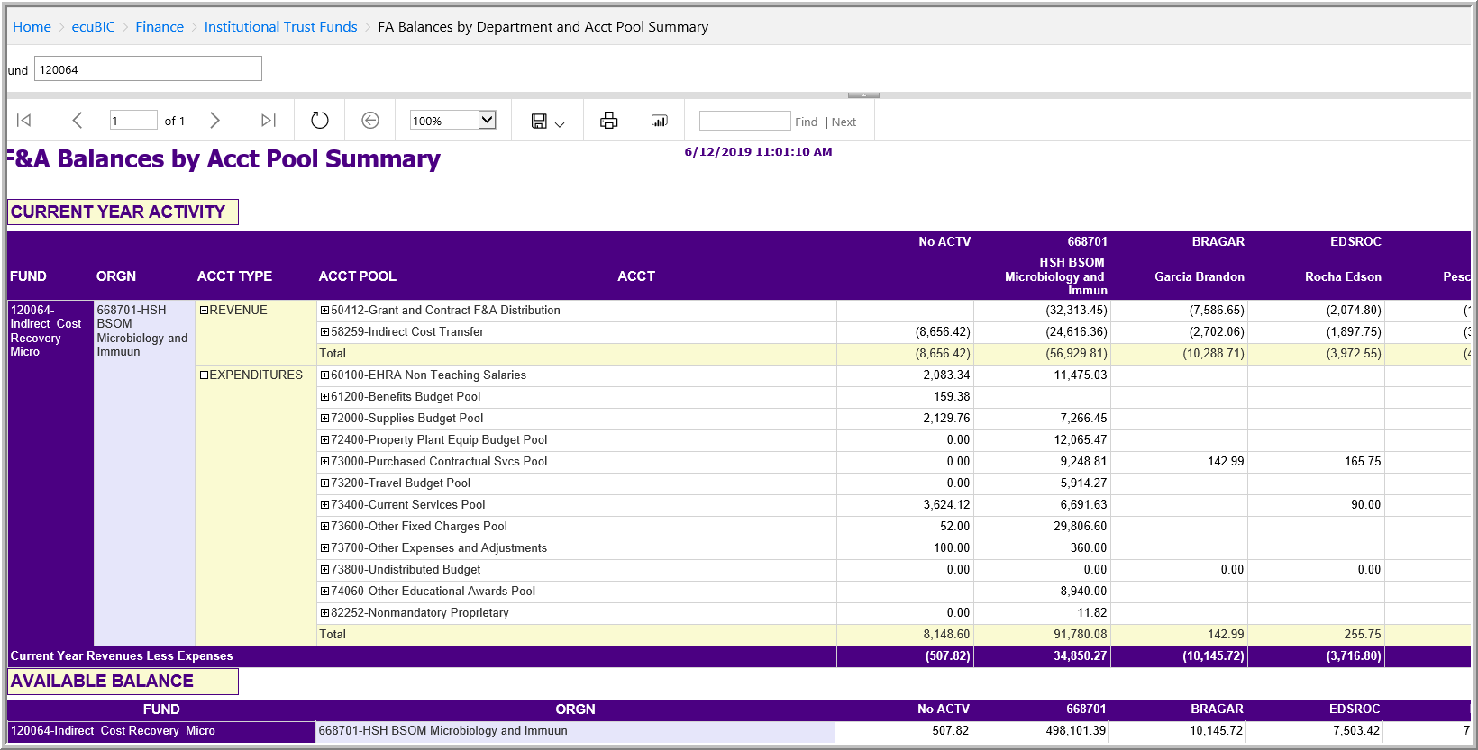
This report can be used to look at the fund in total
To view the detail behind the transactions click the + beside the account and the click the underlined number
This will need to be reclassified to the correct PI
Current PI Balance

Slide 14
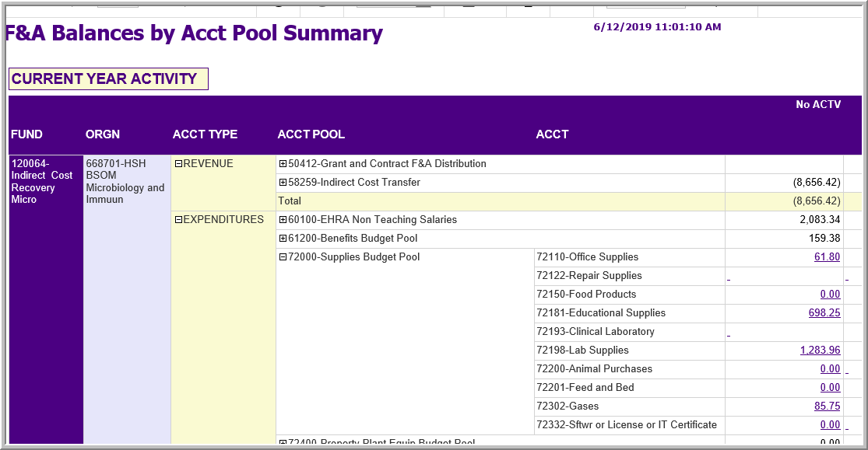
Let’s look at the Office Supplies. Click the $61.80 to drill down.

Slide 15
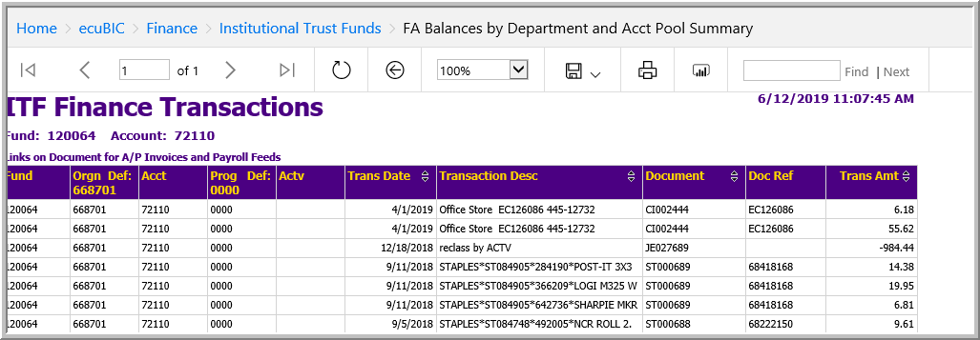
Theses transactions posted with no actv code
= 61.80
This form can be exported to excel. Click the floppy disk icon and then click excel.
Once in excel you can copy and paste to a blank JE and add the activity and debit/credit
These two transactions will need to transferred to the correct activity code.
These numbers are positive so they are debits.
The No Activity should be credited to clean this up and the correct activity code should be debited.

Slide 16
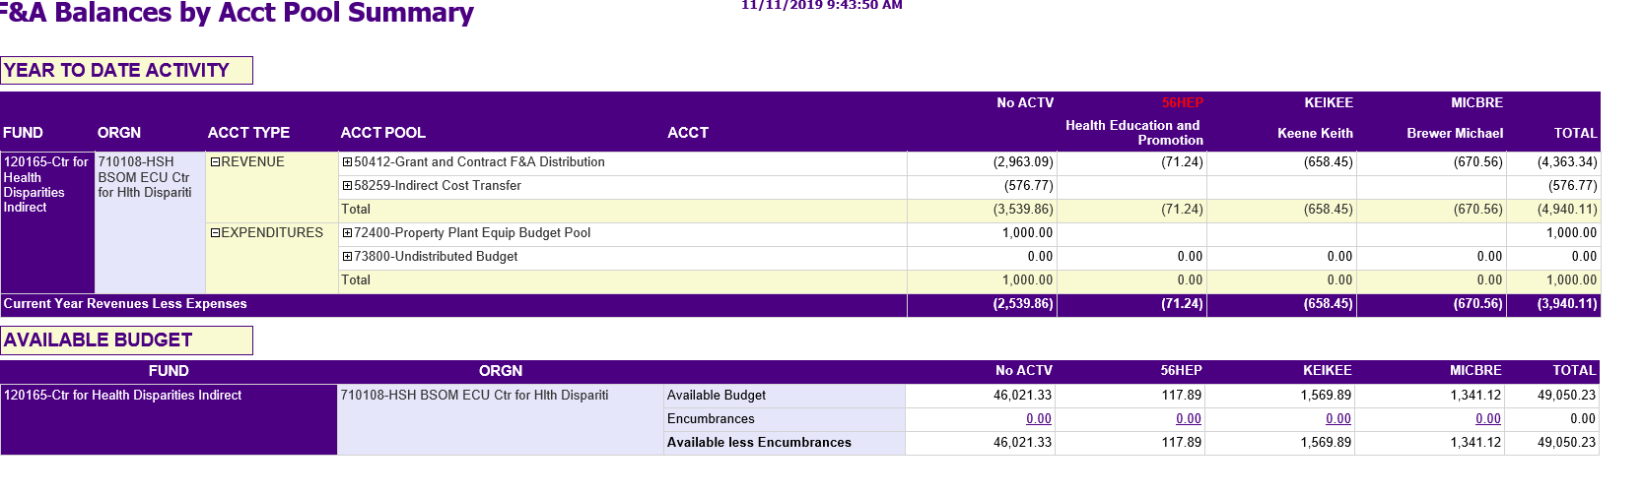
Columns with red lettering indicates an invalid activity code, these transactions, as well as No ACTV, will need to be reclassified to the correct PI.
Grant and Contract F&A Distributions can post with the incorrect activity code (such as 56HEP above) when the grant distribution codes are not set up correctly in the system. This usually means the grant doesn’t have an activity code assigned to the distribution for this fund. If this occurs on your fund please contact your grants administrator.
Other activity codes that are not PIs or the department will also need to cleaned up such as 56KIPL

Slide 17
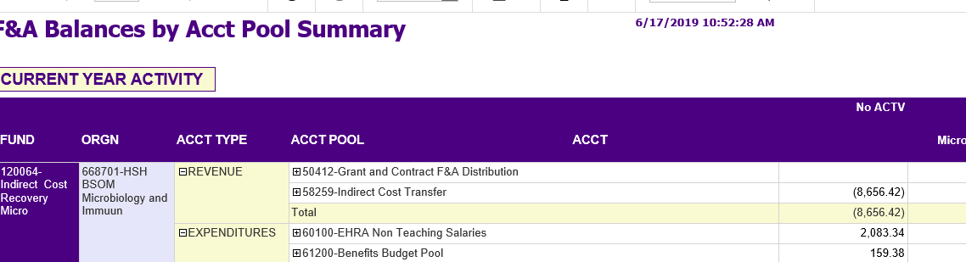
EPAFs will need to be submitted to add an ACTV to salary line. If salary is showing in the no activity column a
payroll redistribution is needed.

Slide 18
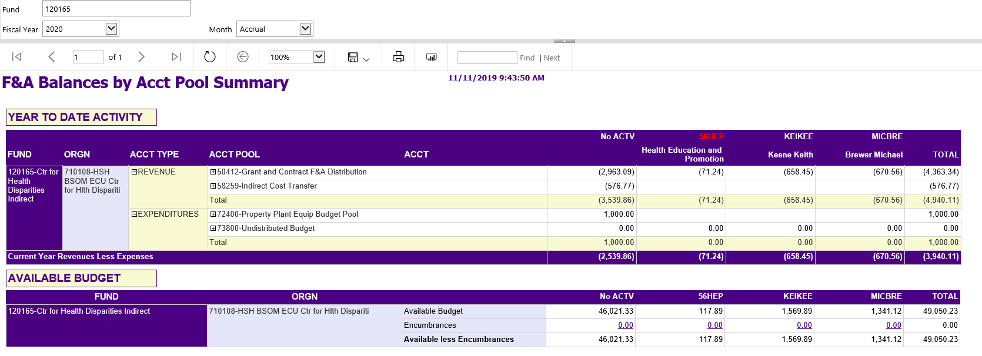
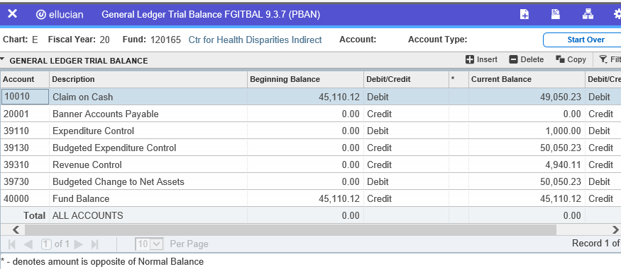
The total cash balance on the ecuBIC report will match to the Banner Admin Pages (Banner 9) cash balance on the FGITBAL screen.

Slide 19
The next report is
FA Balances by PI by Acct Pool Summary

Slide 20
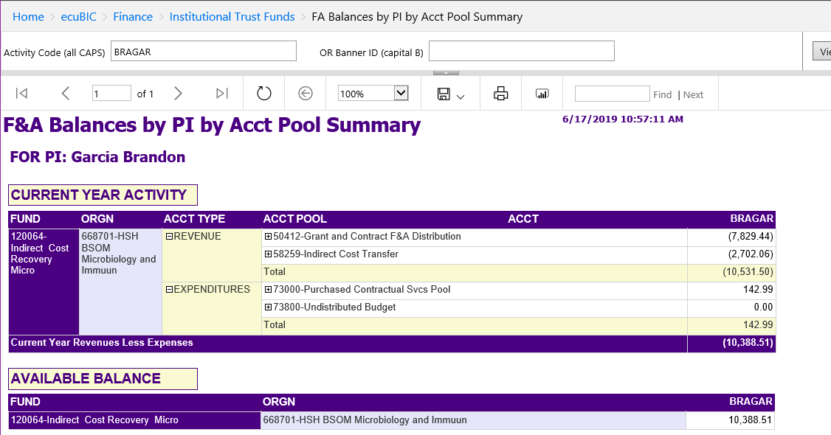
You can review the report by a single PI or a PI can review their own individual report. This report can be emailed weekly if you request a subscription to be set up.

Slide 21
College Level F&A FUNDS

Slide 22
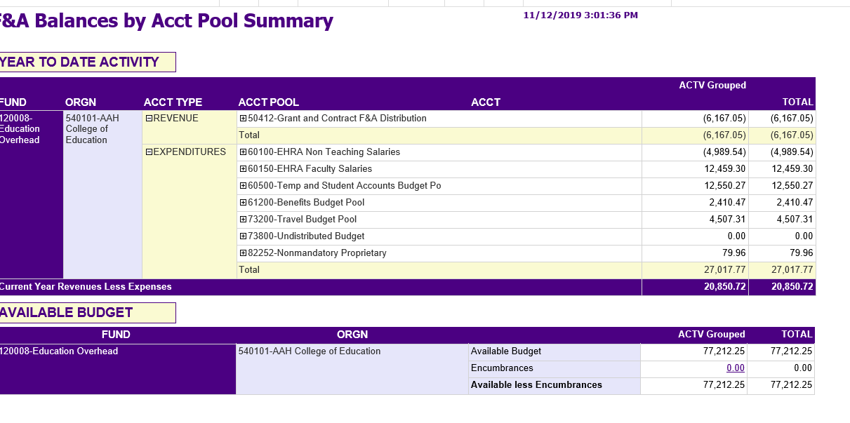
College level F&A Funds do not need to use activity codes because they are not tracking revenue and expenses by PI. When viewing FA Balances by Department and Acct Pool Summary for a college level fund, everything will show under ACTV Grouped.

Slide 23
Contact Us if you have questions
Sharon Cullipher, CPA
  737-1403
  Anthony Bechtel, CPA
    737-1143
  Michelle Yeager
    737-1138
    ITF-SPECIALFUNDS@ecu.edu

