Slide 1
TSM-Supplier Registration
End User Procedures

Slide 2
Contact Information
Bridget Brown-Supplier Management Supervisor
Supplier Management email: ECU-SUPPLIERMGMT@ECU.EDU

Slide 3
What is TSM
Total Supplier Manager: Managing Supplier Relationships
A web-based centralized repository of your entire supplier file
Pre-qualification management
Diversity certification tracking & verification of suppliers
Onboarding automates supplier setup processes for payables from prospect to active-paying supplier, including ACH payment information collection, W8/9 document collection and TIN matching.
Notes:
Informational***Allows departments to stay with in federal compliance. Give the responsibility to the Supplier.

Slide 4
Total Supplier Manager gives you:
Insight into supplier capabilities and their status in adhering to East Carolina University's business requirements.
Elimination of many manual processes for managing the supplier database.
Formalized data collection that reduces discrepancies across supplier profiles for more consistent, accurate and reliable supplier information when generating reports.
Reduction in risk exposure brought by dealing with third-party suppliers.
A clear and simple-to-navigate user interface for rapid user training and adoption.
Notes:
Informational***

Slide 5
Search Link

Slide 6
Search for Supplier: Banner ID Search
Utilize The ECU BIC ID Search to search for possible existing suppliers before sending a request.
Short cut on Home page of Port.
Search by Last name, First name, Company name, DBA (Doing business As), TIN (tax identification number)/SSN, Banner ID.
% at the beginning and end of the first few letters of the search allows multiple choices to review.
Notes:
Reminder…

Slide 7
Notes:
ABC cleaning Service may actually be Abby B. Clemmons dba ABC Cleaning Services

Slide 9
Candidates, Research Participate, Resident/Fellow
Click East Carolina University logo to go to Shopping Home page
Select Candidates, Research Participants…Under ECU Catalog section.

Slide 10
Candidates, Research Participate, Resident/Fellow
Candidates, Research Participants, Resident or Fellows Information
Individual’s Name
Mailing & Email Address
Requestor name and department
Notes:
Informational***

Slide 11
Candidates, Research Participate, Resident/Fellow
Supplier Management will be notified once the request is submitted.
Supplier Management will email or mail the individual the “Non-Supplier Individual Information Form” and IRS link to the federal tax document that need to be completed.
Once the individual has submitted the required forms, Supplier Management will create a BID and email the Requestor

Slide 12
Requesting a New Supplier
Go Supplier Management, located to the left on the side bar.
Then Requests. Click on Request a New Supplier
Notes:
Thread: Supplier Management-Manage Suppliers-Search for a Supplier.

Slide 13
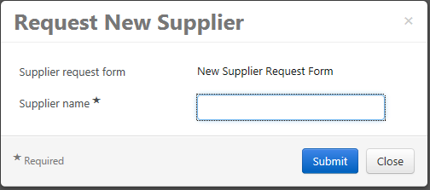
Request New Supplier
This box will pop up for you to start the New Supplier Request Form
Type in the supplier name (remembering the format) and click Submit.

Slide 14
Requesting a New Supplier: Naming Format
Format to remember for Supplier Name:
Company Name: Entire name-EX: 501 Fresh, Bricks by Jill
Individual Name: Last name, First name-Ex: Calhoun, Jill
The correct format indicates which supplier request you will complete.
Supplier Management will return request if Individual naming format is incorrect.
The asterisks symbolizes a requirement
Notes:
Informational***Be cautious of dba’s. Small business is known as business name, but actually an individual with a dba. Again…ABC cleaning Service may actually be Abby B. Clemmons dba ABC Cleaning Services

Slide 15
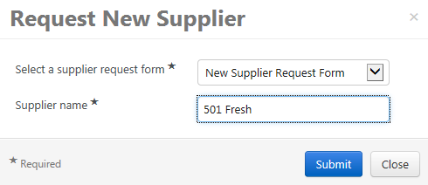
Name formatting Examples Company: Entire name
Notes:
Example of naming format

Slide 16
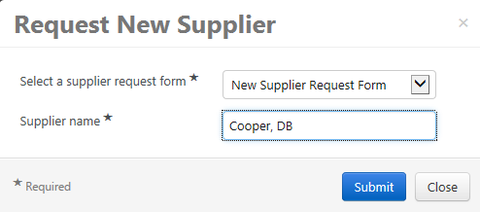
Name formatting Examples Individual: Last name, First name
Notes:
Example of naming format

Slide 17
New Supplier Instructions
Follow instructions and click Next
Notes:
Note:

Slide 18
Supplier Information Fields
Supplier Name* Required (remember the formatting) will be returned if incorrect
DBA Supplier Name
Tax ID Number
DUNS Number
First Name
Last name
Email Address* Required
Supplier Website
Notes:
Informational***Supplier Name* and Email Address* are required to move forward. All others are optional.

Slide 19
Supplier Overview
Confirm spelling and format of supplier name.
Scroll down.
Enter Supplier email.

Slide 20
Supplier Overview: Additional Supplier Information
Complete required fields
Scroll down
Answer corresponding questions
Notes:
Both sections are required. This will assist Supplier Management in deciding which type of Invitation to email to the Supplier.

Slide 21
Supplier Overview: Supplier Information for Independent Contractors/Individuals
List of Questions per Supplier Type. This will assist Supplier Management in recognizing supplier relationship and interest.
Was the Individual previously employed by East Carolina University?
Is the Individual a previous student of East Carolina University?
Is the Individual currently employed by a North Carolina State Agency?
Provide a detailed description of the services being provided by the Individual to East Carolina University?
Notes:
Informational***End Users can save progress and return later. Questions are different for Company. Currently Employed by a NC agency (possible dual employment) reimbursement only…not service related.

Slide 22
Supplier Information for Independent Contractors/Individuals
Will East Carolina University control or have the right to control what the Individual does and how the Individual does his or her job?
Will this Individual supervise East Carolina University employees?
Will this Individual interact with students or patients?
Will East Carolina University provide tools or resources to the Individual in order to perform their tasks?
Does the Individual provide similar services to other Clients?
Notes:
Informational***

Slide 23
Supplier Overview: Supplier Information for Purchasing Suppliers/ Company
List of Questions per Supplier Type. This will assist Supplier Management in recognizing supplier relationship and interest.
Why should East Carolina University engage in business with the supplier?*
Has the supplier previously done business with ECU under a different name or TIN?*
If yes, provide the Supplier’s full name, DBA name, or TIN.
Notes:
Informational***

Slide 24
Supplier Information/Questions
You have the option to “Save Progress”.
Complete the answers the click.

Slide 25
Review and Complete: Certification
You should see all green check marks.
Certify and Complete Request.
Click yes in the pop-up box
Notes:
Complete Request and click Yes to move on.

Slide 26
After Submission: Department Email
Form Request Workflow for Sanders, Debbie is Pending Approval
Dear Cindy Lulu,
Sanders, Debbie has been submitted into Form Request Workflow and is awaiting approval in the Folder: Supplier Request Approval.
Click here to view the request in your organization's site
Department email: Supplier Management has received notification of the submitted form request
Notes:
Informational***

Slide 27
After Submission: Supplier Email
Dear DB Cooper, You are receiving this email because a Department at East Carolina University requested you be added to our Supplier database. By clicking on the “Register Now” button below you will be routed to the secure registration portal to complete the registration process. If you have question or concerns related to the registration process please contact East Carolina University’s Office of Supplier Management at ecu-suppliermgmt@ecu.edu or by phone at 252-737-5325 or 252-737-1098. Register Now
Sincerely ECU Supplier Management
Supplier email: ECU dept has requested them to be a supplier
Notes:
Informational***

Slide 28
Denial/Approval: Department Email
End User email: informing the end user that the supplier has been approved or denied.
Supplier Management will also send an email with the BID if approved.
RE: DB Cooper has been Approved in Supplier Registration Workflow Dear Cindy Lulu, DB Cooper has been Approved in Supplier Registration Workflow Thank You, East Carolina University Supplier Management ecu-suppliermgmt@ecu.edu
Notes:
Informational***Please remember to tell your potential supplier that ECU will communicate requirements, issues and approvals all through email.

Slide 29
Form/Document Search
To view any form or document submitted, follow the thread:
Orders and Documents on the your side
Document Search
Search Document
This will allow you to view the status of all forms for suppliers and also for candidates, research participants, etc…

Slide 30
Form/Document Request Search
Follow the thread
Select your options to view from the dropdown box
Click Go

Slide 31
Forms/Documents View
Click the name to review

Slide 32
Manage Supplier Requests
Follow the thread to view your requests: Supplier Management-Requests-
Manage Supplier Requests.
Click on the supplier name you wish to view

Slide 33
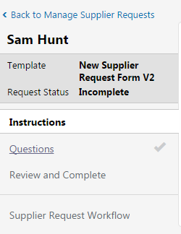
Supplier Request Workflow and Review
Click on Supplier Request workflow to review the steps

Slide 34
Workflow Step
Green Check = completed
Active = in review

Slide 35
Frequently Asked Questions
1. Why is ECU changing procedures?
To eliminate paper, ensure ECU is compliant with Federal and State regulations and guidelines, and to offer ACH payments to suppliers.
2. What happens if I do not get the naming format correct?
Supplier Management will review information and you will be notified. If the naming format for the Individual suppliers are incorrect, we will return the request back to you for correction.

Slide 36
Frequently Asked Questions
3. How do I know what supplier type to select?
It will be up to you to keep lines of communication open with the supplier. Share with the supplier our procedures and also the notifications that will be emailed to them.
4. Are previous suppliers already in the system?
Selected ECU suppliers with payment activity within the last 3 years will be placed in TSM.

Slide 37
Overview
End User will communicate with the supplier and gather required information.
Search for the supplier on ECU BIC report, Request a Supplier and enter required information.
Supplier Management will receive notification of request, review for completion, send the supplier an invitation via email supplied on the request from the end user.
The supplier will create a profile and complete required sections.
Supplier Management will receive notification of completed invite and process through the workflow.
An email will be sent to the end user and supplier informing them of the workflow completion, approval/issues, and that the supplier is ready to use.
Notes:
Informational***

Slide 38
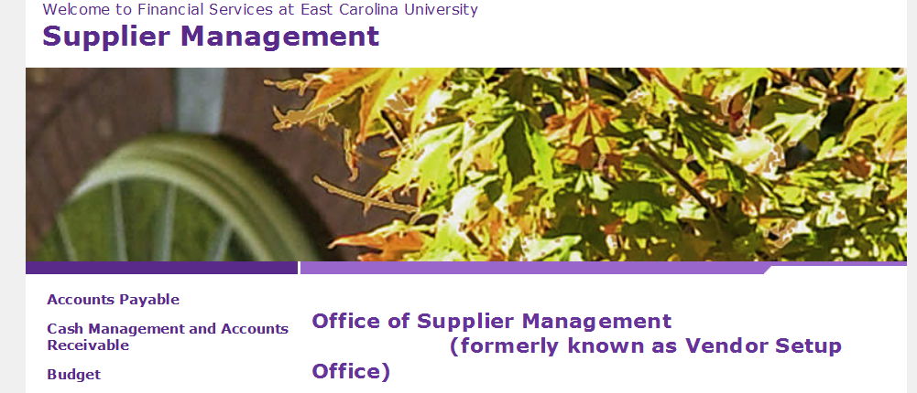
Total Supplier Manager
https://financialservices.ecu.edu/supplier-management/
Notes:
Informational***

Slide 39
Group Questions and Answers

