Slide 1
Presenters- East Carolina University – Financial Services
Elisa Heller
Disbursements Manager
252-737-5442
BURGESSE@ECU.EDU
Dawn Boyd-Cribari
Chrome River Administrator/Travel & Reimbursement Supervisor
boydcribarid20@ecu.edu

Slide 2
Analytic Dashboards
for both
VC and/or Finance
&
Admin “The Cockpit” Team

Slide 3
VC or FINANCE DASHBOARD

Slide 4
Designed for the higher-level Finance Leader
Provides general overview of the expenses within your Chrome River System.
Check the pulse of the University on the spend that flows thru the Chrome River system at your institution.
Grab a user friend PDF or access via your tablet at the Executive Steering Committee
Have your updated figures to discuss with other key leaders
Easily toggle between your various sub-organizations to quickly answer RFIs from outside agencies or leadership

Slide 5
Dashboard Highlights: 100% Customizable to your desires
Current Year Spend by Month (Exported/Non-Exported) Column
Chart
Non-Exported Spend
• Percentage % (0-30 Days) Timeliness
• Total Amount
• Aging by Draft, EWallet, Returned, Pending
Credit Card
• Adoption Rate
• Amount Rebate Forfeited
• Transaction Analysis by $ Amount

Slide 6
Continuation with Dashboard highlights
Reports with Approvers > 14 Days (Bottleneck Report)
Aging of Open eWallet Transactions
Mileage Analysis
Trips > 400 Miles
Amt Reimbursed by Traveler past 24 M
Quick Links to “Deeper Dashboards”, aka “In the weeds)
Detail Analysis Report, quick download for any reporting

Slide 7
Examples of the VC Dashboard

Slide 8
Examples of the VC Dashboard

Slide 9
ADMIN DASHBOARD “THE COCKPIT”

Slide 10
Designed for the Chrome River Administrator and Team that is in charge of running the system within the Organization.
Aimed at providing comprehensive oversight into their unique instance and provide indicators as well as easily downloadable reports to take immediate action into key areas to improve efficiencies in the system and keep reports moving accurately and efficiently thru the system.

Slide 11
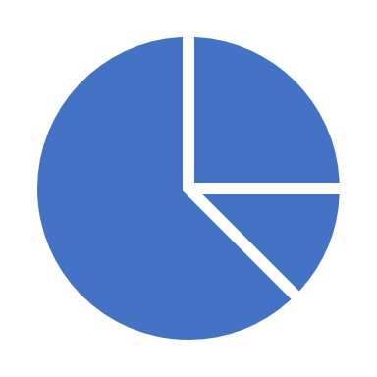
Dashboard Highlights: 100% Customizable to your desires
Overall Roll Up Past 12 months
Amount Spend
# of Reports/Owners
Processing Time Averages
Spend Charts comparing current and one past year
Report Count vs Contracted Amount to visually see Contract line and
Avoid “Overage” costs per contract (if applicable, based on contract)
BackOffice Review Count of Reports and Aged awaiting final approval
BackOffice Count by Person Header/Report Line – Used for Reviews

Slide 12
Continuation with Dashboard highlights
NonExported Spend
• Aging in Draft/Pending/Returned
• Percentage % (0-30 Days) Timeliness
• Aging of Draft/EWallet/Pending
• EWallet Aging by Card and # of Trans/Owners/Amt
• Report – Ewallet > 30 Days
• Aging of EWallet by Card Name/Cash Advance
• Card Analysis by Vendor
• Card Analysis by Amount of Trans
• Report – Open Cash Advance
• Inactive Employee Amount & Report
• Inactive Approver Amount & Report

Slide 13
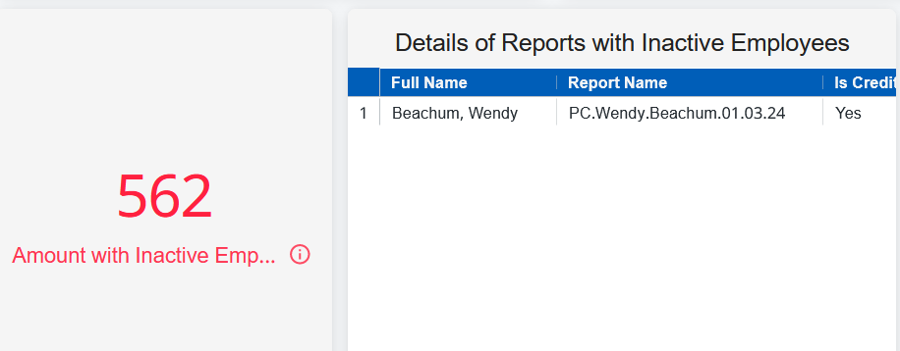
Examples of the Admin Dashboards

Slide 14
Examples of the Admin Dashboards

Slide 15
Summary- Analytics Pro
Empowers various users, office managers, department lead admins, etc. to handle the business aspects for their different colleges and be the liaison for drafting reports
Takes the burden off of our department to create the reports. A win-win for all!
Data security is in place- every user sees just their piece of the pie
Allows VC’s to see the BIG picture
Allows System Admins (cockpit) of their Chrome River to see critical back- end alerts

