Slide 1
Financial Services Workshop Financial Planning and Analysis
March 2024

Slide 2
Financial Planning & Analysis Staff Building 165 – 209 East 3rd Street
Budget Contacts
Business Intelligence Contacts
Dawn Quist – Director
Tim Morris
Lisa Edwards
Heather Taylor
Laura Fanning
Yolanda Hill
Patrick Everett
Van Bledsoe
Pat Robinson

Slide 3
Financial Planning & Analysis
Agenda
About our Office
All Funds Budget
Budget Information
Position Budget

Slide 4
Financial Planning & Analysis
Provide financial and budgetary support in resource planning, university budget preparation and monitoring for East Carolina University.
Coordinate the preparation of the state budget requests, the university’s all funds budget process and administer those budgets once they are approved.
Provide data for campus leadership to support decision making to achieve the university’s mission and strategic goals.

Slide 5
Why Develop an All-Funds Budget
Requirement of UNC System for a comprehensive operating budget
Planning and use of resources
Align funding with priorities of strategic plan

Slide 6
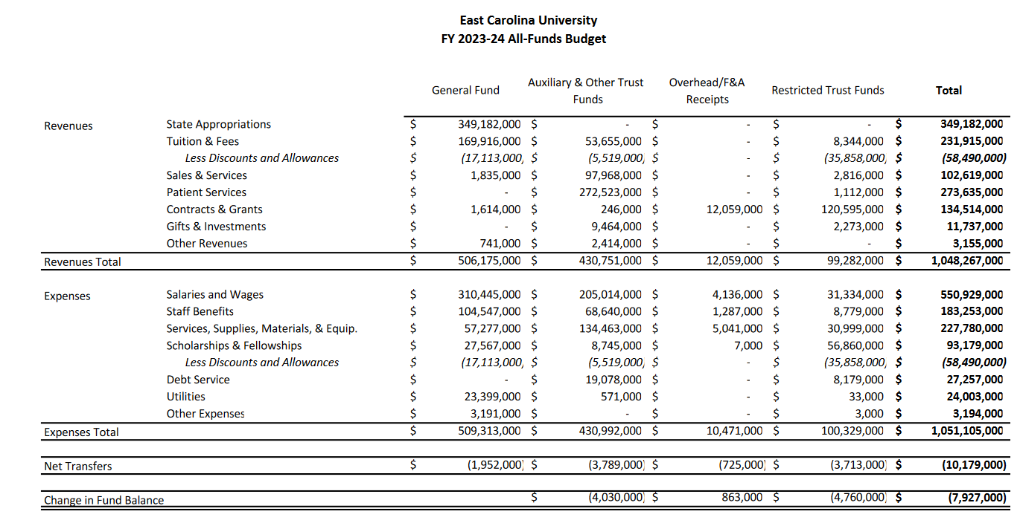
All Funds Budget Template- Summary

Slide 7
Unit Level

Slide 8
All Funds Budget
Projections
General Fund – FY24 budget plus for FY25 enrollment funding change
Auxiliary & Other Trust Funds, Overhead Receipts and Restricted Trust Funds
Department/Division budget officers project budgets

Slide 9
All Funds Budget – Exclusions
All funds budget focuses on operating items.
Capital-related revenues and expenses are not included; however, budgeted transfers to capital are included.
Funds that are not governed by the university are excluded (endowments, foundation funds, loan funds and agency funds).

Slide 10
All Funds Budget Timeline
November 3, 2023 – Communicate budget guidelines to Division Offices
January 9, 2024 – Budgets due to the University Budget Office
April 11, 2024 – Board of Trustees approve FY25 all-funds budget
May 22, 2024 – Board of Governors reviews budget at meeting
July 2024 – University Budget Office begins loading budgets into Banner and reconciling budgets to the All Funds Budget.

Slide 11
Deans and Directors Dashboards
Released in December 2023
Provides planning for the following fund types:
General Funds (State)
Auxiliary and Institutional Trust Funds
Overhead Receipts
Restricted Trust Funds
Foundation Funds
Uses Banner Org Security

Slide 12
Analysis
Available Now
Budget Planning
Revenue and Expense Tracking
Fund Balances
Historical Three-Year Trend Analysis
Coming Soon…
Monthly/Seasonal Analysis
Drill-through to Transaction Level
Forecasting
Much, Much More!

Slide 13
Live Demo
Admin & Finance Operational App

Slide 14
Questions?

Slide 15
B22 and B44 Update
Budget Entries in Self Service Banner
Nonstate funds can now use B22 and B44 rule class
Nonstate transfers must remain within the same fund and orgn.
Currently, you cannot transfer from a 7 account to an 8 account, but we have a ticket in to correct this.

Slide 16
Budget Transfers
B11 are permanent transfers and B22 are temporary transfers moving funds from one operating pool account (7xxxx) to another:
Example: From 111101-720101-72000-0000
To 111160-720101-73600-0000
B44 are temporary transfers moving funds between salary accounts (605xx – Nonstudent or Student Pay) and operating pool accounts (7xxxx) ONLY.
Example: From 111101-550702-73400-0000
To 111101-550702-60521-0000
Note: B44 Temporary Transfers will be routed to the Budget Office for approval.

Slide 17
Looking Ahead
Automated negative clean up process to operating budgets on nonstate funding sources has just begun
Anaplan – workgroup will be developed to get feedback on Anaplan for budget development and gain insight on improvements that users would like to see implemented.
People Admin Budget Queue instead of approver

Slide 18
Good Reports to refer to
ecubic.ecu.edu
Single Position Listing - Power BI Report Server (ecu.edu)
Multiple Positions Listing - Power BI Report Server (ecu.edu)
Notes:
Position 002612 for single position

Slide 19
PCF Tips
Use the current date as the effective date unless it is a future year temp PCF.
We do not get the notification when a PCF goes into suspense. You must tell us and ask for help.
Only one Perm PCF can be submitted on a position at a time. It must be approved by our office and applied before a new one can be completed.
Temp PCFs can be one after another, don’t have to wait for our approval.

Slide 20
Position Change Form https://pirateporttest.ecu.edu/
Scenarios:
Need to pay a stipend
Employee job duties changed and getting a permanent salary increase
Rehiring position and paying new employee less than previous employee
Notes:
https://pirateporttest.ecu.edu/
PIN 1: 974694
PIN 2: 486423

Slide 21
Website
Many forms and resources are posted on our website.
https://budget.ecu.edu/
Budget Office email – general inbox for budget related questions
budgetoffice@ecu.edu

Slide 22
Questions?

